Slide 1
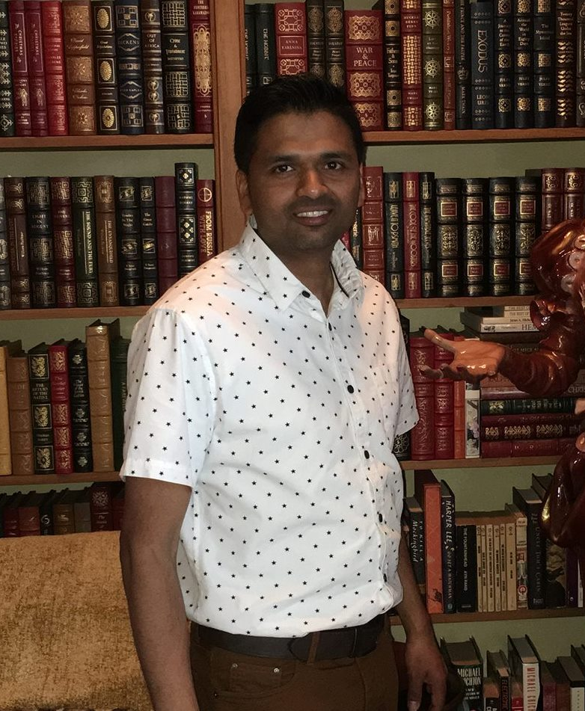
INDIA:
TRACING
OUR INDIAN ANCESTORS
POORAN BRIDGELAL

Slide 2
The content of this video, as well as the thoughts, views, and opinions expressed herein belong solely to the creator and do not necessarily reflect the views of FamilySearch International and RootsTech.

Slide 3
WHERE TO START?
MEMORY BOX – Notepad, Pen and USB
Interview Relatives – Ask open-ended questions

Slide 4


FAMILY SEARCH MEMORIES

Slide 5
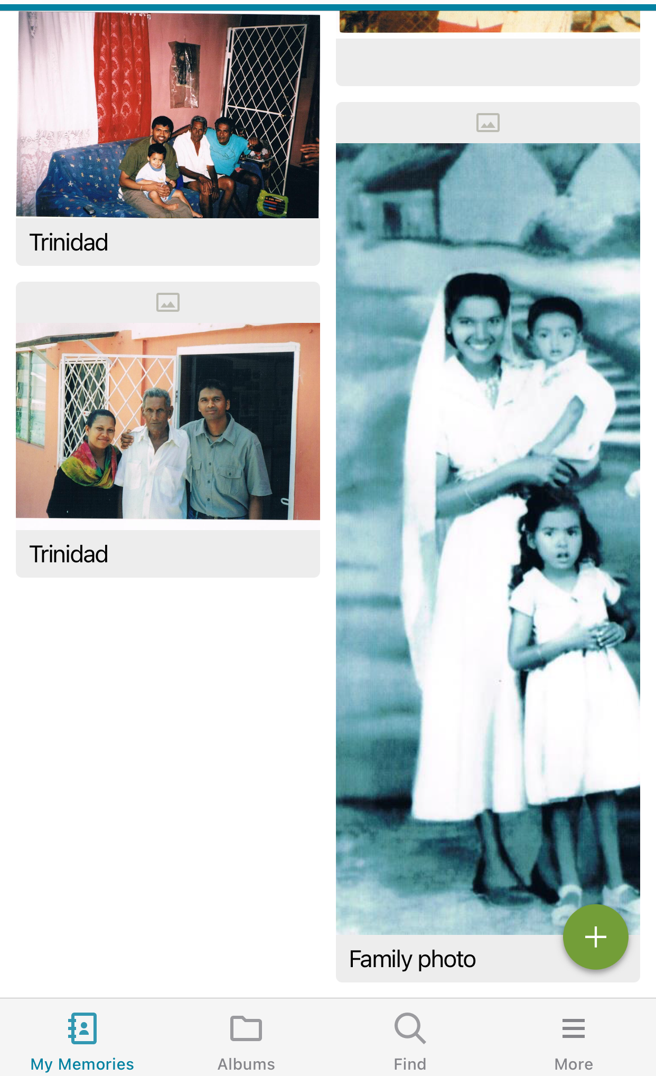
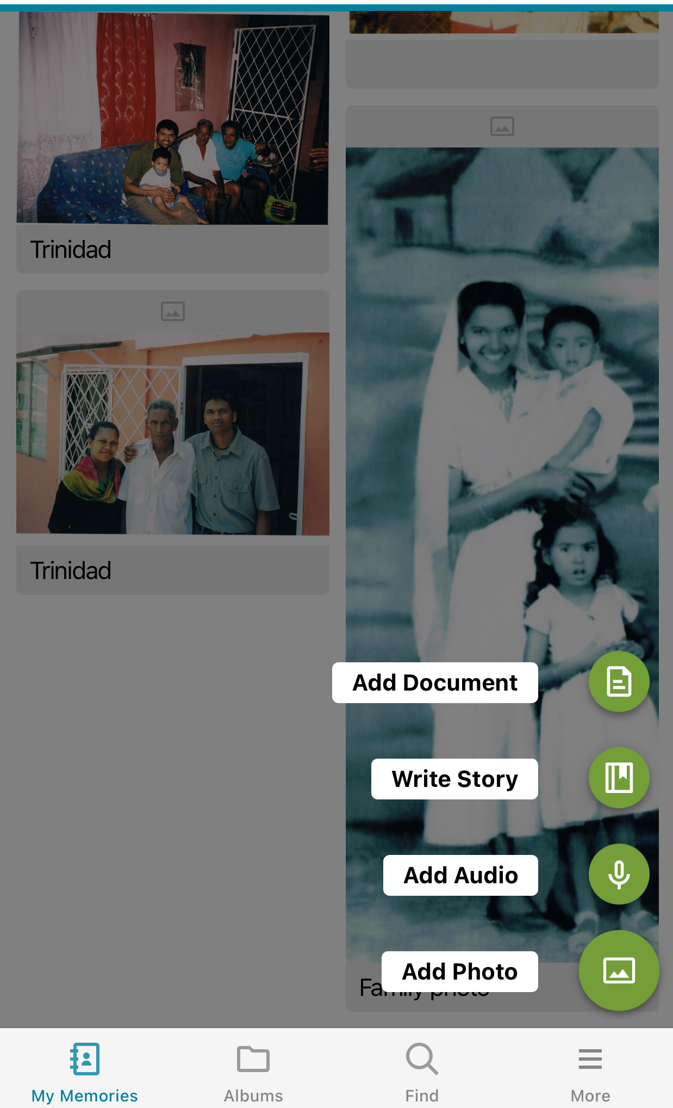
MEMORIES APP

Slide 6
RESOURCES
- FOLLOW THE PAPER TRAIL: Looking for physical evidence proving the existence of your ancestor
- YOUTUBE: WHO DO YOU THINK YOU ARE?
FINDING YOUR ROOTS
- ROOTSTECH CLASSES
- FAMILY SEARCH: https://www.familysearch.org/indexing/ https://www.familysearch.org/discovery/

Slide 7
There are NO BRICK WALLS!
Pooran Bridgelal

