Slide 1
Introduction to Koseki Reading and Interpretation –
Part 2 (Dates and Family Relationships)
Martinus (Marty) Wolf 狼

Slide 2
The content of this video, as well as the thoughts, views, and opinions expressed herein belong solely to the creator and do not necessarily reflect the views of FamilySearch International and RootsTech.

Slide 3
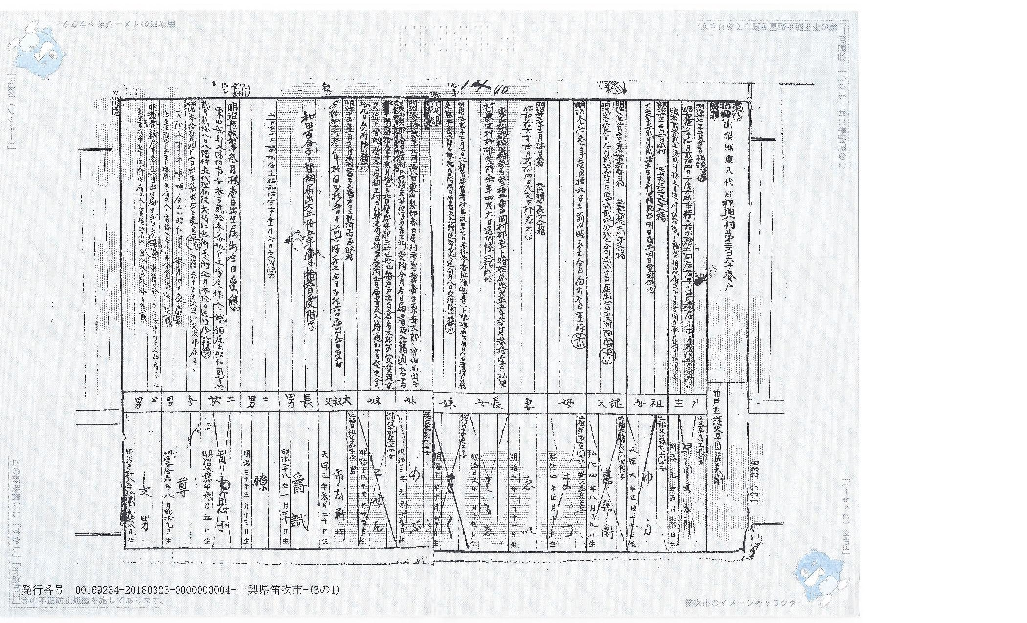
日本の家族歴史 (Japanese Family History)
Introduction to Koseki Reading and Interpretation
Part 2

Slide 4
Class Topics
Part 1
  Introduction
  Basic koseki layout
Part 2
  Dates
  Family Relationships
Part 3
  Names
  Geographic place names

Slide 5
数字の単語 (Number Vocabulary)
一 (ichi) – one
二 (ni) – two
三 (san) – three
四 (shi) – four
五 (go) – five
六 (roku) – six
七 (shichi) – seven
八 (hachi) – eight
九 (kyū) – nine
十 (jū) – ten
十一 (jūichi) – eleven
十二 (jūni) - twelve
Uncommon (usually addresses)
  百 (hyaku) – 100
  千 (sen) – 1,000
Historical/Documents (WIDELY used in koseki documents)
  壱/壹/弌 (ichi) – one
  弍/弐/貮 (ni) – two
  参/參 (san) – three
  拾 (jū) – ten
  廿/卄 (nijū) – twenty
  丗/ 卅 (sanjū) – thirty

Slide 6
Dates
Dates – Standard Format
  年号 (Era)
  年 (Year)
  月 (Month)
  日 (Day)
Western dates are NEVER used in koseki.
Look for Year/Month/Day pattern (年月日)
The era is always a two character identifier – most important are 明治 (Meiji) and 大正 (Taishō)

Slide 7
日本の年号 (Japanese Eras)
享和 (Kyōwa 1-4; 1801-1804)
文化 (Bunka 1-15; 1804-1818)
文政 (Bunsei 1-13; 1818-1830)
天保 (Tenpō 1-15; 1830-1844)
弘化 (Kōka 1-5; 1844-1848)
嘉永 (Kaei 1-7; 1848-1854)
安政 (Ansei 1-7; 1854-1860)
万延 (Man’en 1-2; 1860-1861)
文久 (Bunkyū 1-4; 1861-1864)
元治 (Genji 1-2; 1864-1865)
慶応 (Keiō 1-4; 1865-1868)
明治 (Meiji 1-45; 1868-1912)
大正 (Taishō 1-15; 1912-1926)
昭和 (Shōwa 1-64; 1926-1989)
平成 (Heisei 1-31; 1989-2019)
令和 (Reiwa 1-???; 2019-???)

Slide 8
時間の単語 (Time Vocabulary)
年 (nen) – year
月 (tsuki) – month
日 (nichi) – day
元年 (gannen) – first year of an era (always)
正月 (shōgatsu) – first month of the year (rare)
朔日 (tsuitachi) – first day of month (rare)
晦日 (misoka) – last day of month (rare)
年月日不詳 (nengappi fushō) – unknown date (rare)
午前 (gozen) – A.M.
午後 (gogo) – P.M.
時 (ji) – hour
分 (fun) – minute
Note – Japan switched to the Western Gregorian calendar on January 1, 1873 (from 5th day in 12th month in 1872 to 1st day in 1st month in 1873). In general, immigration documents do not account for this switch.

Slide 9
Dates – Example #1
明治参拾四年壱月拾九日生
明治 – Meiji Era
参拾四年 – 34th year
壱月 – 1st month
拾九日 – 19th day
生 – birth
Born on January 19, 1901

Slide 10
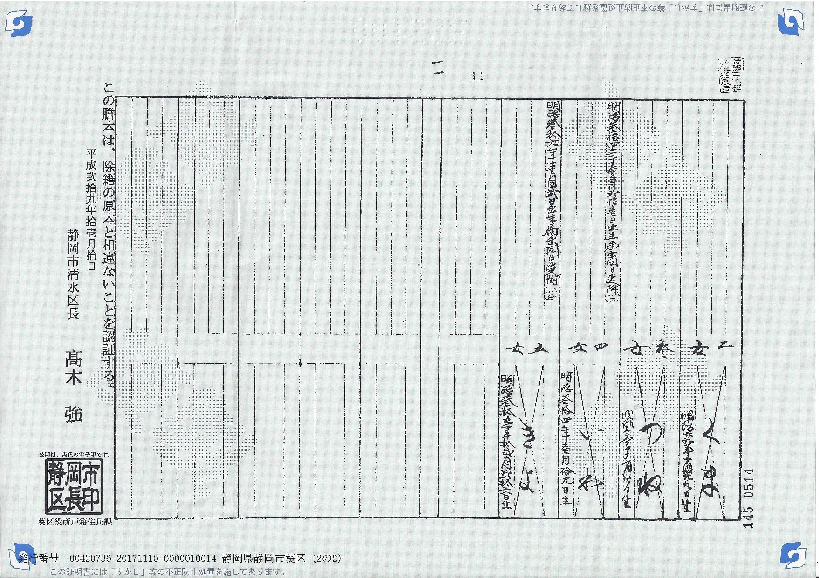

Slide 11
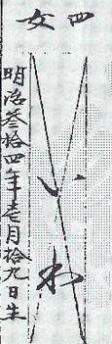
Dates – Example #1
明治参拾四年壱月拾九日生
明治 – Meiji Era
参拾四年 – 34th year
壱月 – 1st month
拾九日 – 19th day
生 – birth
Born on January 19, 1901

Slide 12
Dates – Example #2
明治参拾四年壱月拾九日生
明治 – Meiji Era
参拾四年 – 34th year
壱月 – 1st month
拾九日 – 19th day
生 – birth
Born on January 19, 1901

Slide 13
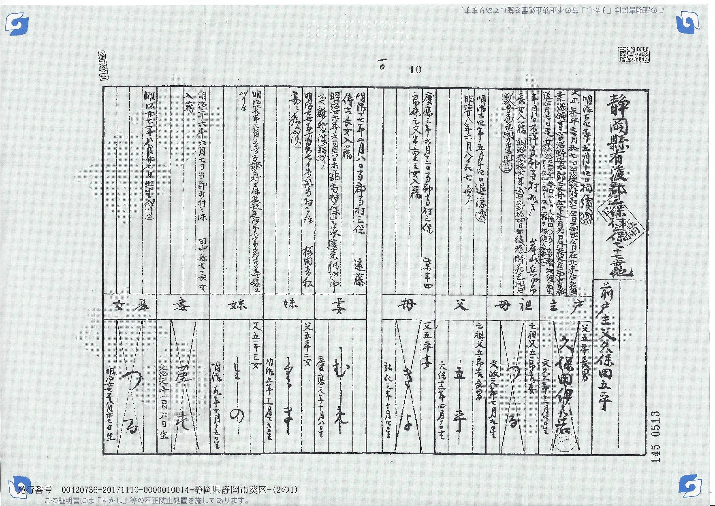

Slide 14
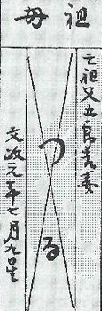
Dates – Example #2
文政元年七月九日生
文政 – Bunsei Era
元年 – “gannen” 1st year
七月– 7th month
九日 – 9th day
生 – birth
Born on July 9, 1818

Slide 15
Dates – Example #3
明治参拾四年壱月拾九日生
明治 – Meiji Era
参拾四年 – 34th year
壱月 – 1st month
拾九日 – 19th day
生 – birth
Born on January 19, 1901

Slide 16
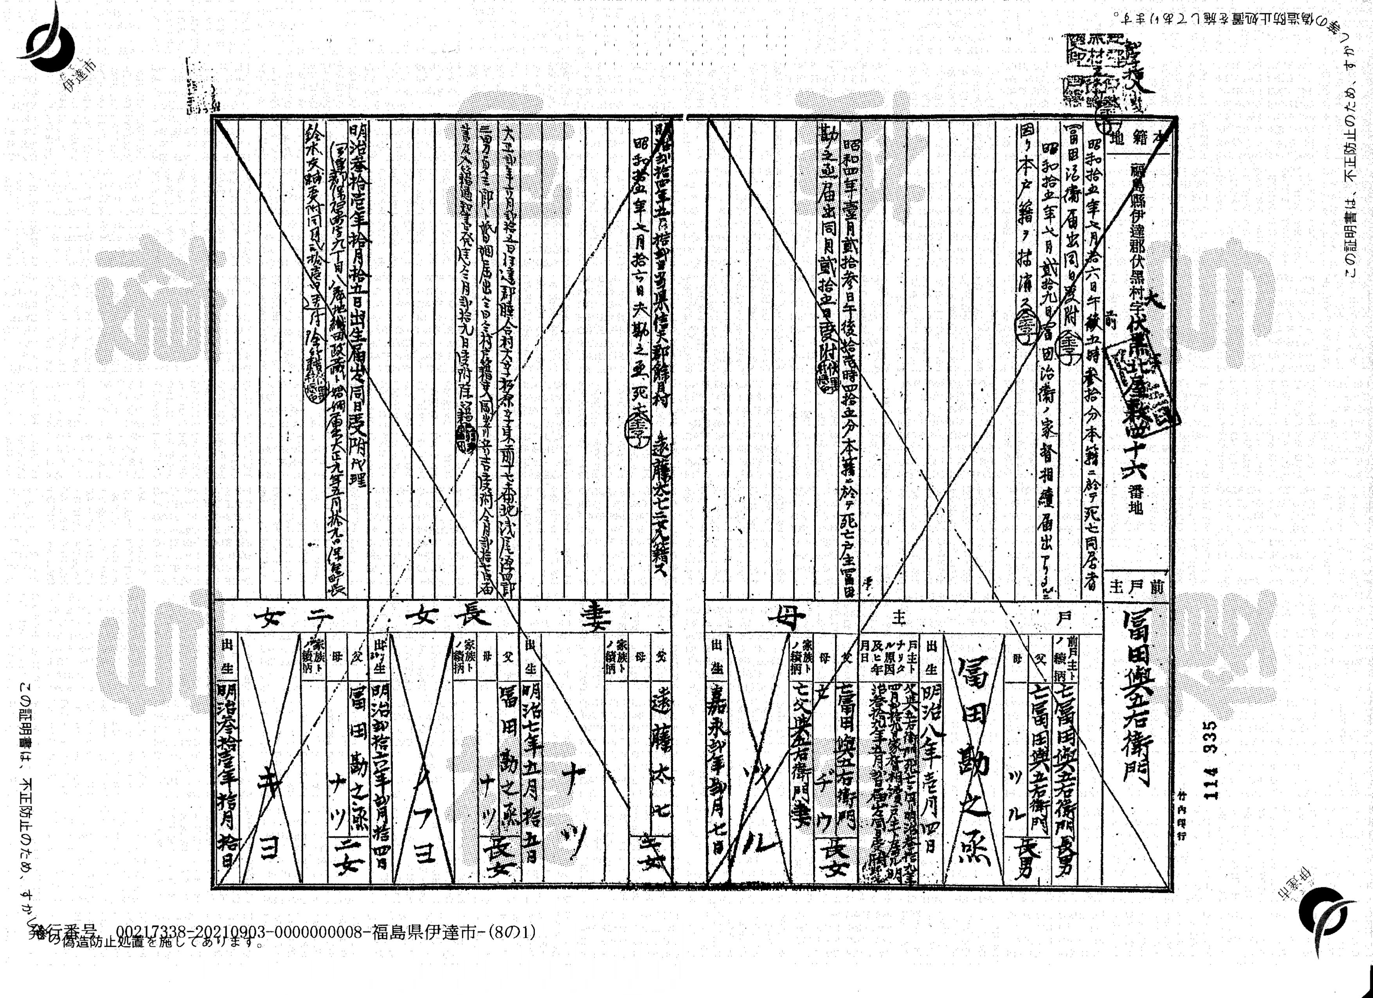

Slide 17
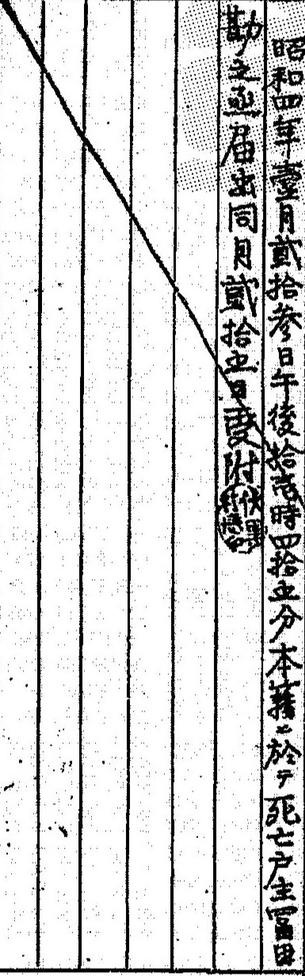
Dates – Example #3
昭和四年壹月貮拾参日午後拾壱時四拾五分死亡
昭和 – Shōwa Era
四年– 4th year
壹月– 1st month
貮拾参日– 23rd day
午後 – P.M.
拾壱時 – 11th hour
四拾五分 – 45 minutes
死亡 – death
Died on January 23, 1929 at 11:45 p.m.

Slide 18
Family Relationships
戸主 – koshu (head of household)
前戸主 – zenkoshu (previous head of household)
The koshu is ALWAYS the first full column on the right side of the first page.
The zenkoshu is to the right of the koshu
The family relationships of individuals listed as columns in the Primary Information section are ALWAYS in relation to the koshu.

Slide 19
Family – Head of Household
戸主 – koshu (head of household)
前戸主 – zenkoshu (previous head of household)
The koshu is ALWAYS the first full column on the right side of the first page.
The zenkoshu is to the right of the koshu.
The family relationships of individuals listed as columns in the Primary Information section are ALWAYS in relation to the koshu.
The family relationships of individuals listed in the Secondary Information section are usually in relation to the individual in that column.

Slide 20
Family – Birth Order
男 – otoko (male)
女 – onna (female)
Number + 男/女 = birth order of son/daughter
For example:
  三男 = (sannan) 3rd son
  四女 = (yonjo) 4th daughter
One exception is for oldest son/daughter. 一 (ichi) is NOT used. Instead, 長 (chō) is used.
  長男 = (chōnan) 1st son
  長女 = (chōjo) 1st daughter
For 2nd son/daughter, 二 (ni) is used in koseki , but in modern day Japanese, 次 is used.
  次男 = (jinan) 2nd son
  次女 = (jijo) 2nd daughter

Slide 21
Family – Direct Family
父 – chichi (father)
母 – haha (mother)
The father is usually head of household on koseki, so 戸主 will be used instead of 父.
However, sometimes the father will “retire” 隠居 (inkyo) as head of household and have a son replace him.
The mother will sometimes (but not always) stay in the koseki if she is widowed.
兄 – ani (older brother)
弟 – otōto (younger brother)
姉 – ane (older sister)
妹 – imōto (younger sister)

Slide 22
Family – Marriage
夫 – otto (husband)
妻 – tsuma (wife)
  Head of household
婦 – fu (wife)
  Everyone else

Slide 23
Family – Generations
祖(so) is used to indicate a grandparent
  祖 + 父 = 祖父 (sofu) grandfather
  祖 + 母 = 祖母 (sobo) grandmother
曽祖 (sōso)is used to indicate a great-grandparent
  曽祖 + 父 = 曽祖父 (sōsofu) great-grandfather
  曽祖 + 母 = 曽祖母 (sōsobo) great-grandmother
息子 (musuko) son
娘 (musume) daughter
孫 (mago) grandchild
曽孫 (himago) great-grandchild

Slide 24
Family – Extended
伯 is used to indicate an older uncle/aunt (relative to own parent)
  伯 + 父 = 伯父 (oji) older uncle
  伯 + 母 = 伯母 (oba) older aunt
叔 is used to indicate a younger uncle/aunt (relative to own parent)
  叔 + 父 = 叔父 (oji) younger uncle
  叔 + 母 = 叔母 (oba) younger aunt
従 is used to indicate a cousin relationship.
  従 + 兄 = 従兄 (itoko) older male cousin
  従 + 弟 = 従弟 (itoko) younger male cousin
  従 + 姉 = 従姉 (itoko) older female cousin
  従 + 妹 = 従妹 (itoko) younger female cousin
甥 (oi) nephew
姪 (mei) niece

Slide 25
Family – Adoptive/Step
The kanji 養 (yō) is used to indicate adoption.
養 + 子 = 養子 (yōshi) adopted child (usually male)
養 + 女 = 養女 (yōjo) adopted girl
養 + 父 = 養父 (yōfu) adoptive father
養 + 母 = 養母 (yōbo) adoptive mother
The kanji 継 (kei) is used to indicate a step-parent relationship.
継 + 父 = 継父 (keifu) stepfather
継 + 母 = 継母 (keibo) stepmother

Slide 26
Family – Illegitimate
A number of terms are used to indicate “illegitimate” children. The stigma of illegitimacy does not appear to have been as severe as in the West, but it is indicated on the koseki documents.
私生児 (shiseiji) illegitimate child – usually on father’s koseki
庶子 (shoshi) illegitimate child – usually on father’s koseki
Xの子 or Xノ子 (X no ko)
  illegitimate child or child born to unmarried mother. Usually on koseki where mother is. Upon mother’s marriage, usually moved to new koseki. Sometimes acknowledged as child by stepfather.
Occasionally, child of unknown/ unconnected origin will show up on koseki.

Slide 27
Family Relationship – Example
明治参拾四年壱月拾九日生
明治 – Meiji Era
参拾四年 – 34th year
壱月 – 1st month
拾九日 – 19th day
生 – birth
Born on January 19, 1901

Slide 28
Younger Sister
Younger Sister
Grand-mother
Head of Household
Daughter 1
Wife
Wife
Mother
Father
Previous Head of Household

Slide 29
Daughter 5
Daughter 3
Daughter 4
Daughter 2

Slide 30
Contacts
Marty Wolf (狼)
  916-540-9236 (text only please)
  marty_wolf@stanfordalumni.org
  Facebook (Martinus Wolf) (select the U.S.-based one)

