Slide 1
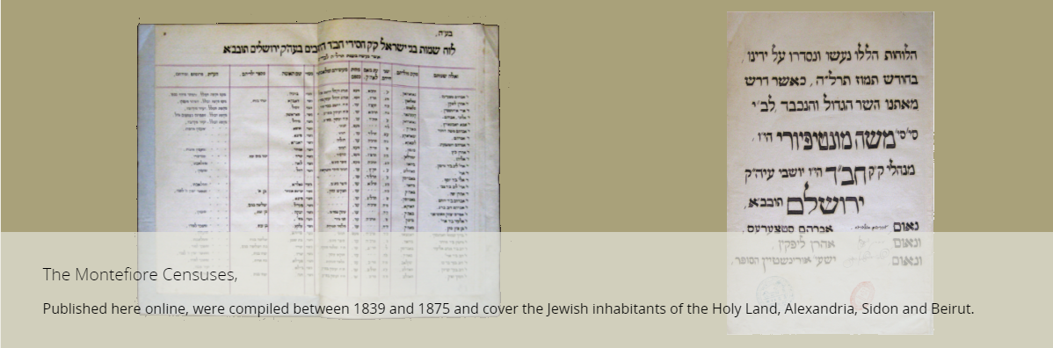
The Montefiore Censuses in the 19th Century © Genealogy Sources in Israel for Every One
Rose Avigael Feldman
March 2022

Slide 2
Details Available in Censuses (sometimes)
Family name, first name,
Age, date of immigration,
Place of birth, marriage,
Name of spouse (not always), children and their ages (not always),
Occupation, financial status and notes
Each Kolel (usually refers to adult education in the area of religious studies, but here it refers to a congregation) includes a list of leaders, the families, the widows and the orphans.

Slide 3
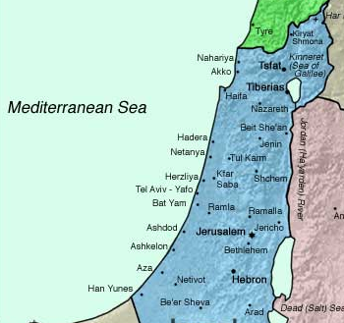
Communities in the censuses 1839 vs 1875
Sidon (Saida)
1839
Safed 1839, 1875
Acre 1839
Shefaram 1839
Djermak 1839
Haifa 1839, 1875
Tiberias 1839, 1875
Tiberias 1839, 1875
Jaffa 1839, 1875
Nablus 1839
Jerusalem 1839, 1875
Hebron 1839, 1875

Slide 4
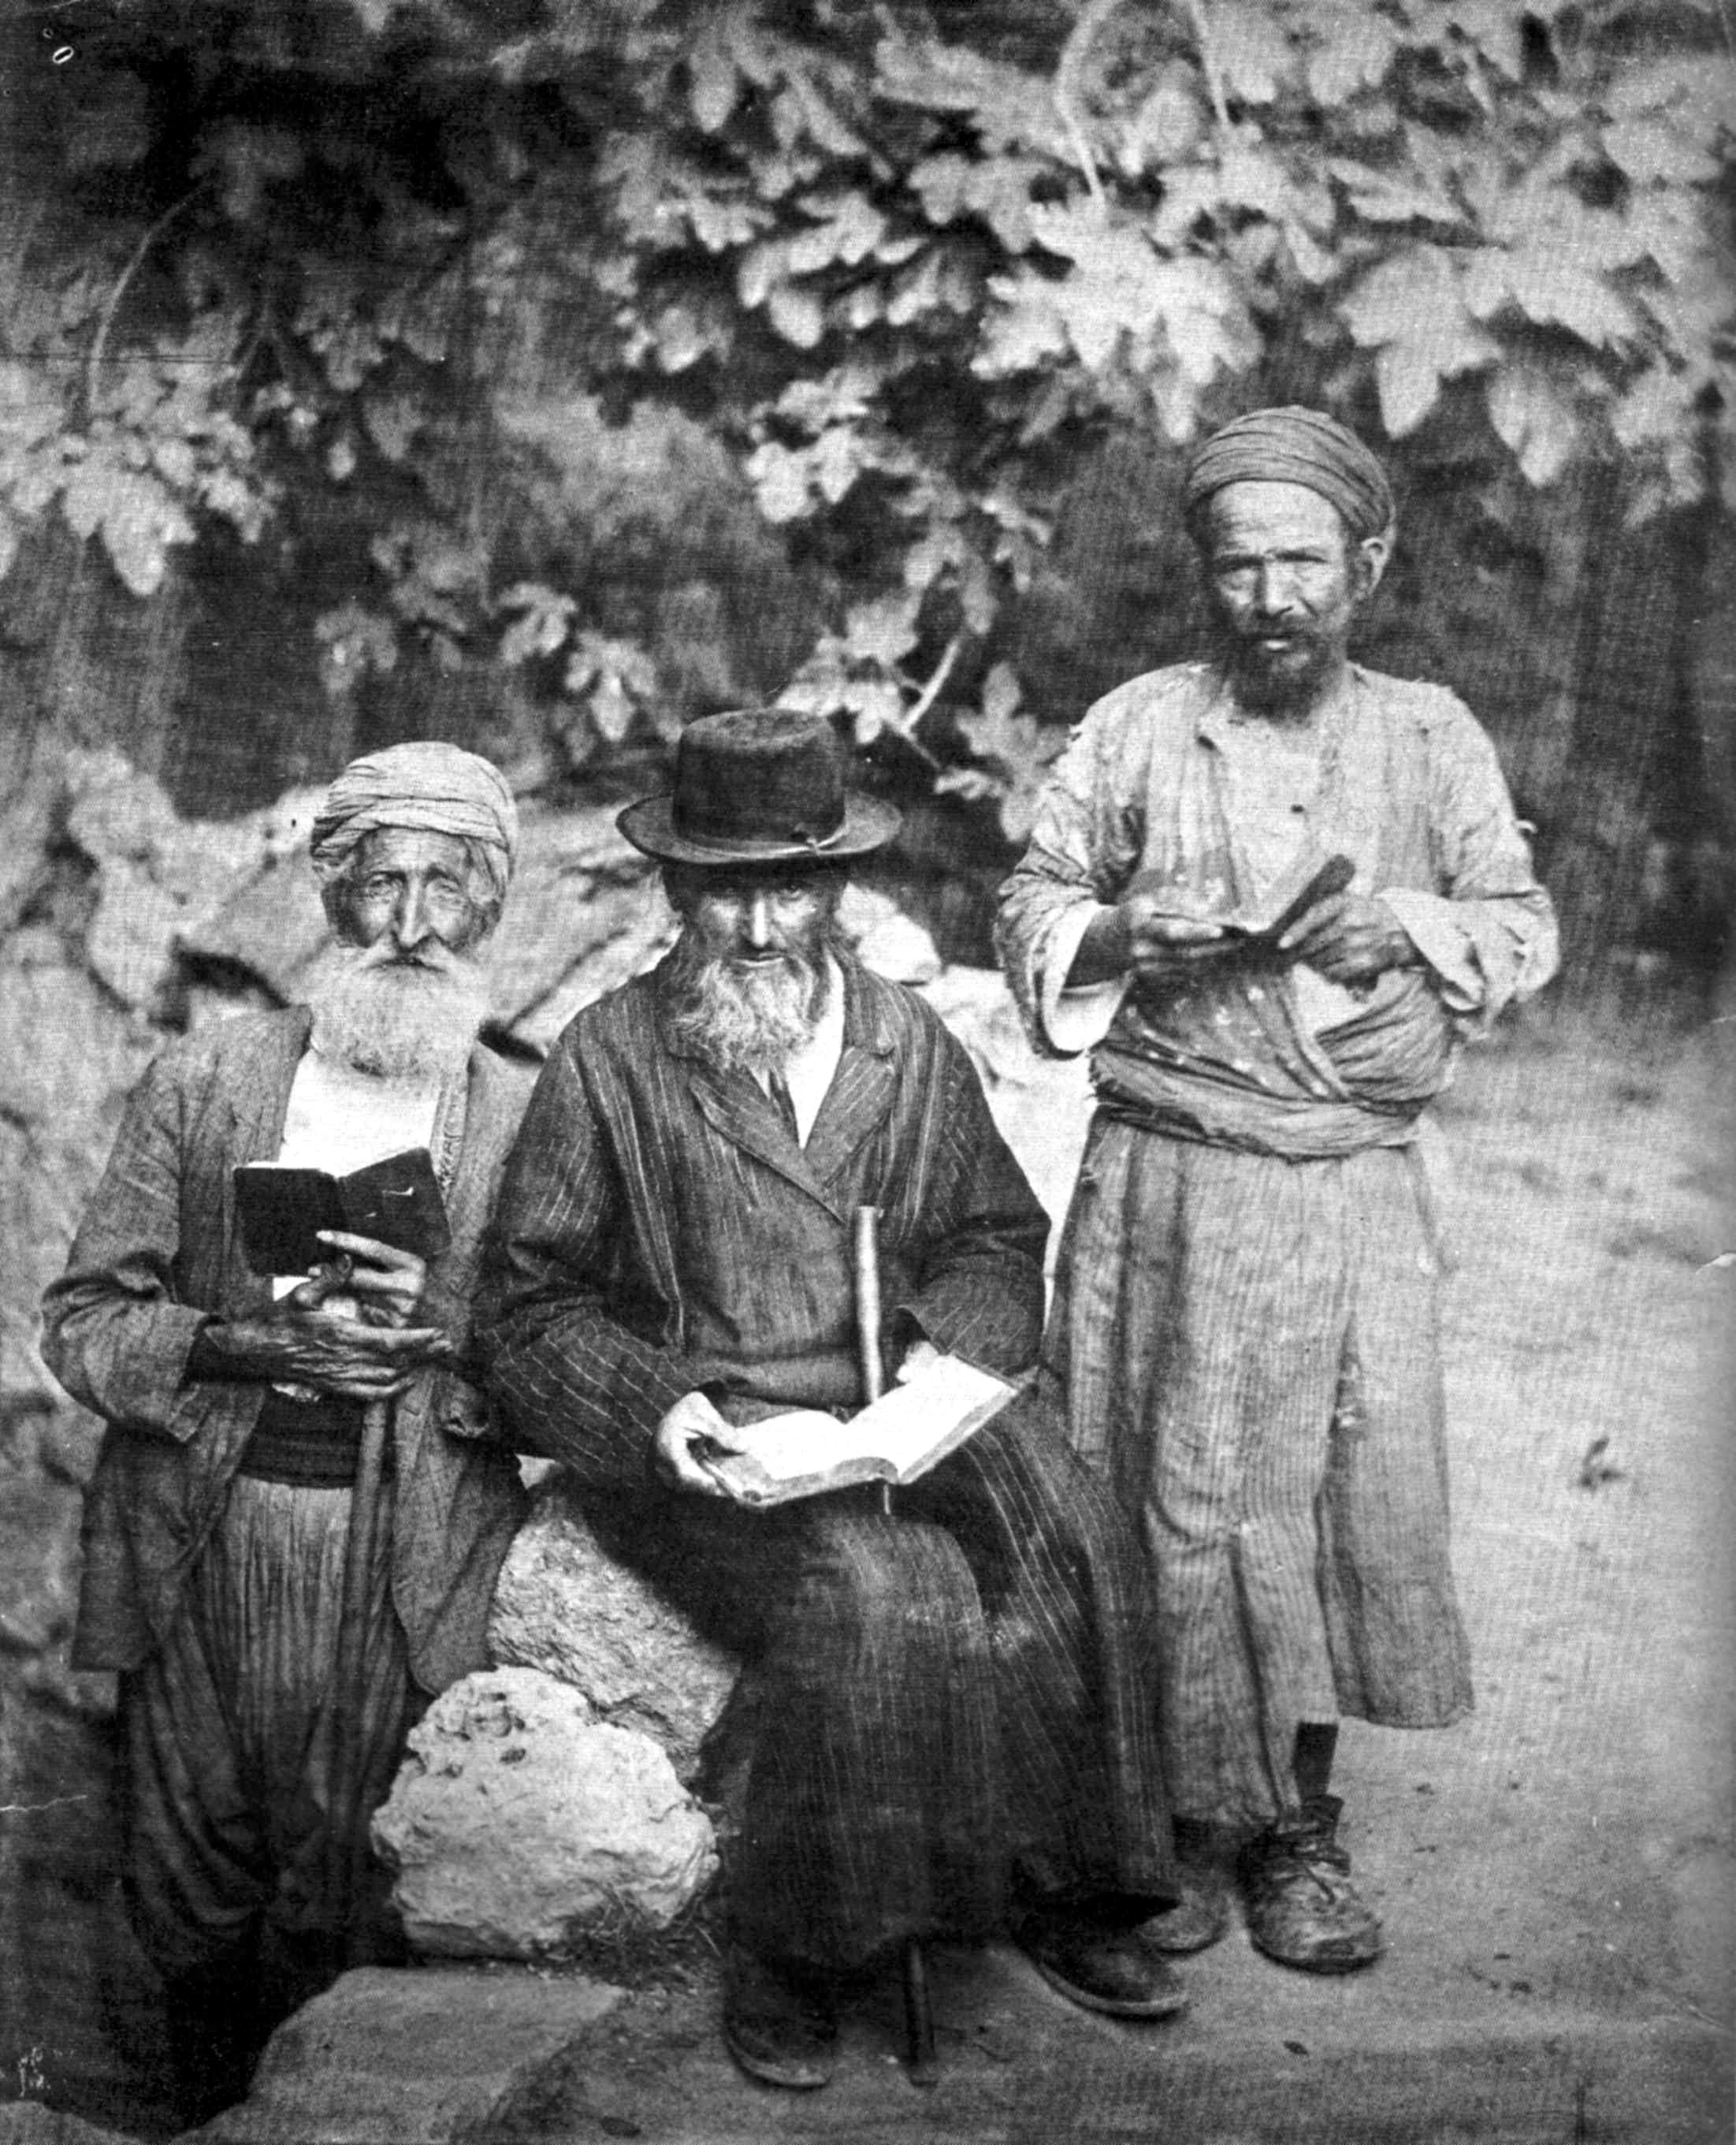
Occupations (1839)
25% have an occupation
listed
9% are “studying” – this includes adults in the Talmud, studying Psalms, etc.
Sometimes the occupation is listed in the financial status column
If listed as studying & occupation, the occupation was chosen
Rabbis and Sages, not
listed as occupation at
this stage

Slide 5
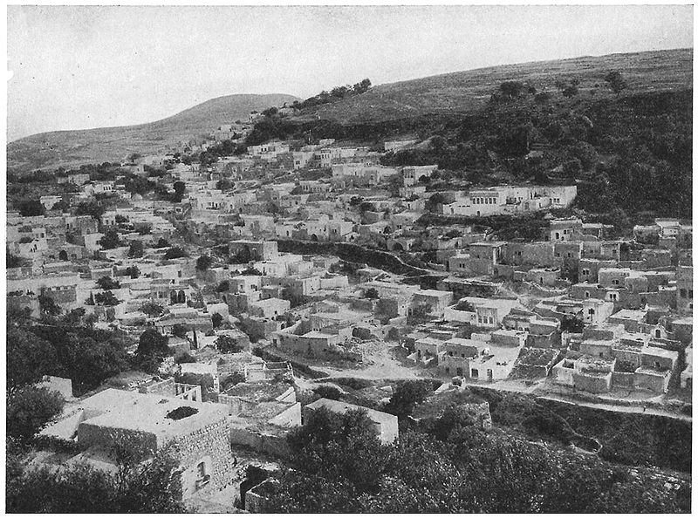
The earliest date of someone born in Eretz Israel according to the census
1749 – Shlomo Sibon age 90 lives in Safed, married, born in Safed
1749 – Shimon Maimaran age 90 lives in Jerusalem, possibly available, born in Jerusalem
1759 – Avraham Palatchi age 80 lives in Safed, blind, born in Safed
1759 – Elihau Arazi, age 80
lives in Safed, lives with
grandson, born in Safed
1761 – Nehemia Castel,
age 78 lives in Hebron,
available, born in Gaza

Slide 6
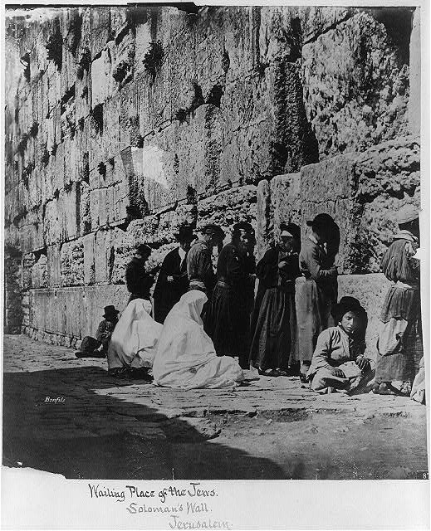
Genealogy even then!
Names of some Rabbis include lineage
Footnotes of the Sephardim in Jerusalem – Chief Rabbi Navon - 4th generation
4 mentions of a person being the grandson and great grandson of a Rabbi
11 mentions of being a grandson of …
2 mentions of being a grand daughter of …

Slide 7
So many different descriptions for being poor !
- destitute, beggarאביון, נשאר אביון
poverty - בדוחק גדול, בדוחק גמור, בדוחק ובצער, בדוחק ישיבות, בדוחק למדן, בדוחק
מקצבתו, בדוחק עני,
בדוחק, נזון בדוחק,
impoverished - ירד מנכסיו,
ירד,
charity - מצדקה,
dole - מקצבתו,
needy - נצרך,
poor - עני, עני גמור, עני דחוק, עני הגון נ"א, עני ואביון, עני ודל, עני וירד מנכסיו, עני ורש, עני מטופל, עני וסומא, עני מרוד, עני ס"נ,

Slide 8
Growth of Jewish Population
Year | Number of Souls | Family Units
1839 | 6,570 | 2,764
1849 | 8,853 | 3,985
1855 | 9,952 | 4,180
1866 | 13,224 | 5,474
1875 | 24,365 approx. | Hard to calculate – double listings
Note that in 1875, many people were listed more than once (e.g. Rabbi & community heads on separate lists, but also with their families. In Jerusalem in particular among the Sephardim, most of the widows were listed twice - once by address and again on the separate widows lists. Since there are very few actual names, it was impossible to link the separate listings. This is all true for previous censuses as well, but not in such great numbers.

Slide 9
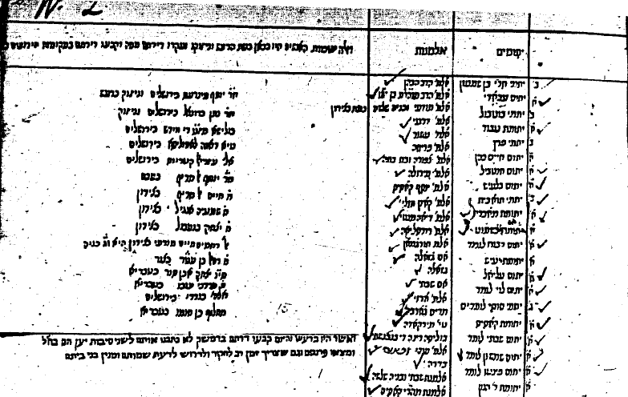
Orphans & Widows Safed 1839

Slide 10
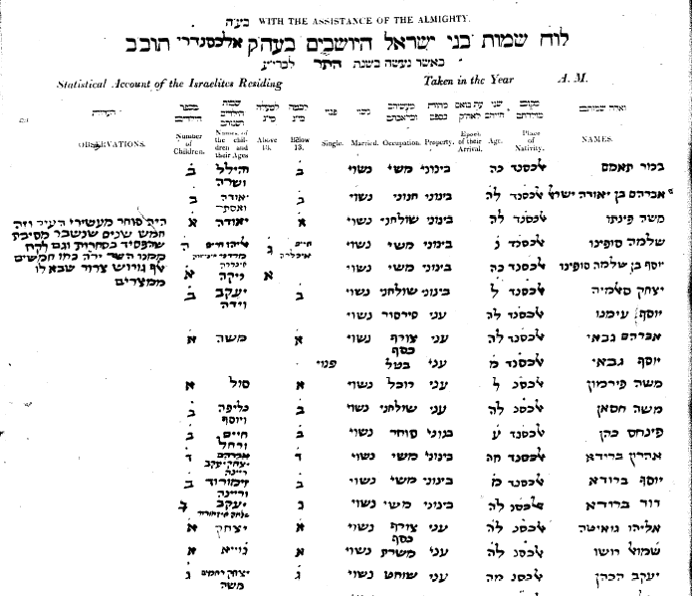
Alexandria 1940

Slide 11
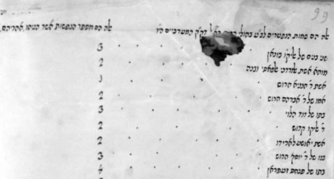
Cholera Epidemic 1865 – page from 1866
Jerusalem Westerners (Mograbim)
# of members of family left

Slide 12
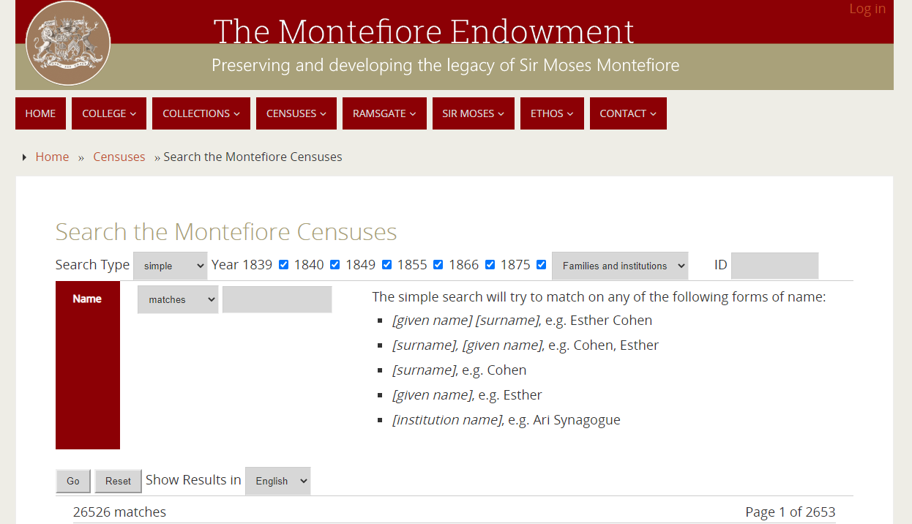

Slide 13
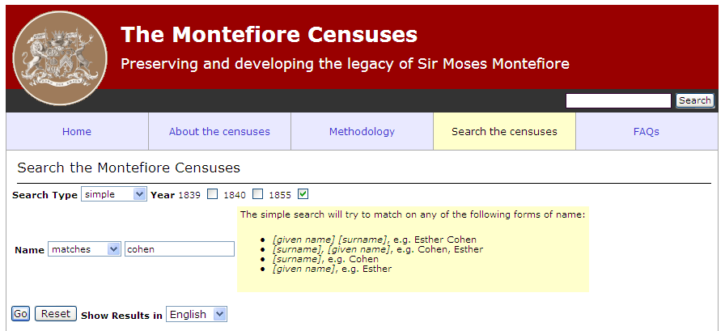
Simple BE CREATIVE – searches family & first name
Year: 1839, 1840, 1849, 1855, 1866, & 1875
Matches/Begins with/Contains/Ends with
Language: English/Hebrew

Slide 14
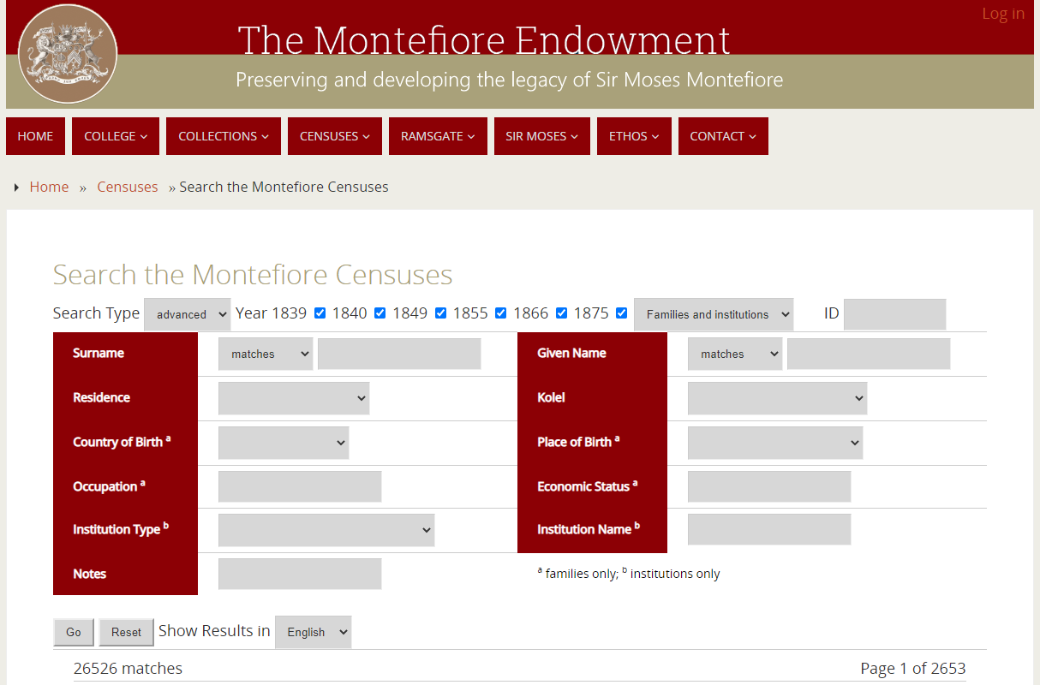

Slide 15
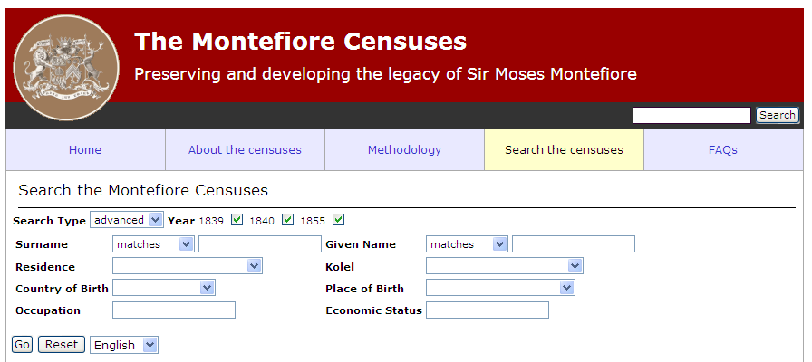
Advanced
Surname Given Name BE CREATIVE
Birth Place DropDown List Country of Birth DropDown List
Residence DropDown List Kolel DropDown List
Occupation Economic Status

Slide 16
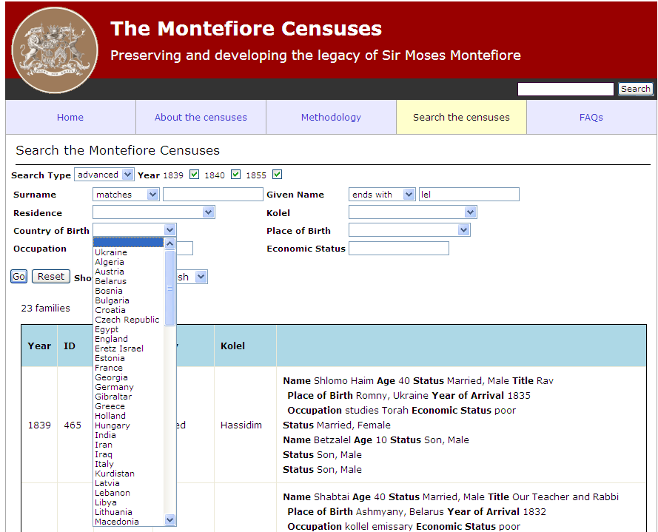
Country of Birth

Slide 17
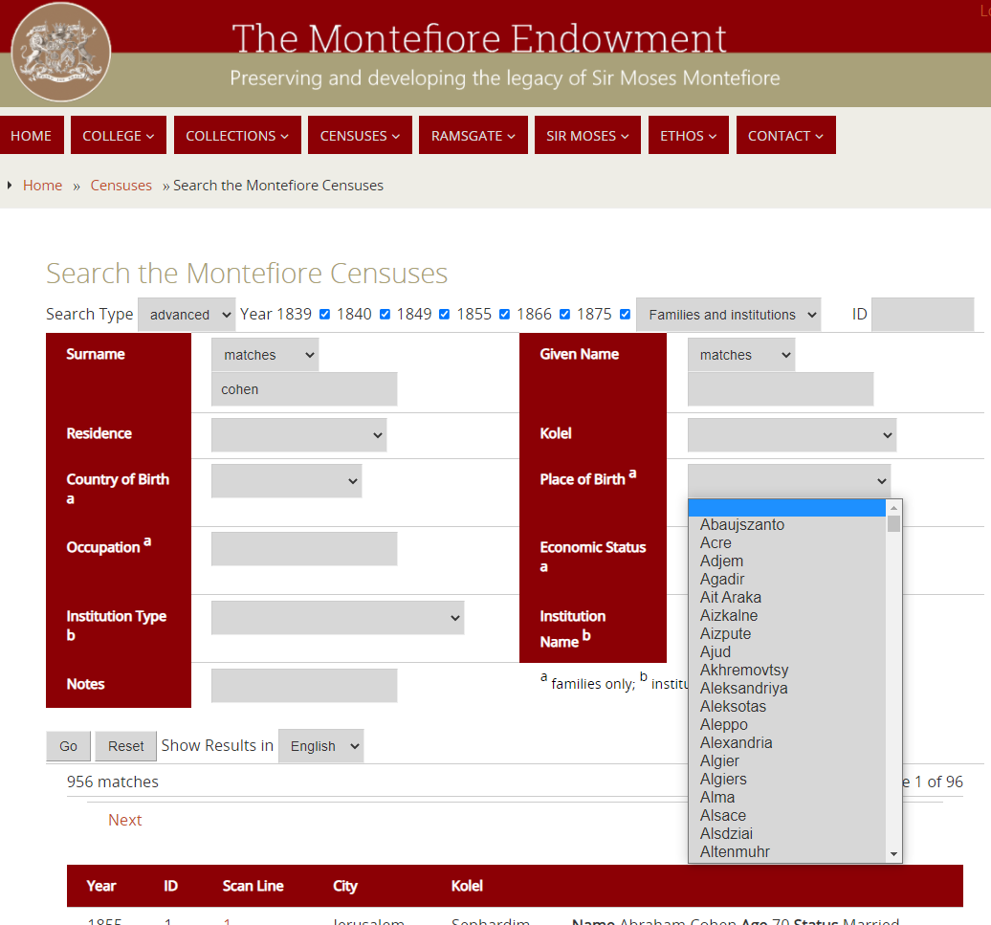
Place of Birth

Slide 18
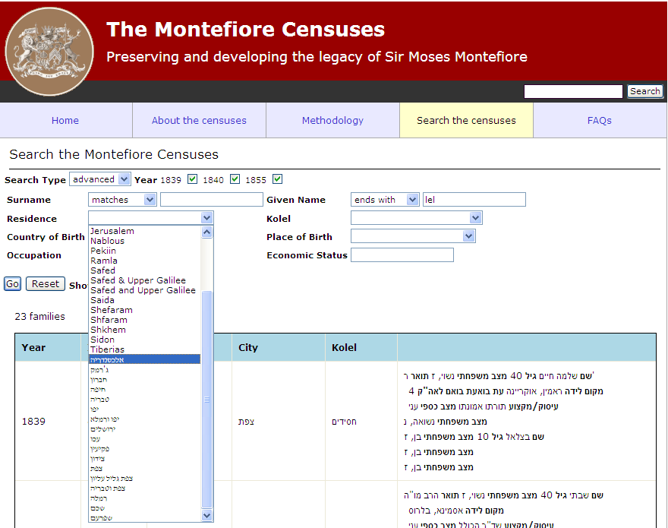
Residence –
Eretz Israel / Ottoman Empire

Slide 19
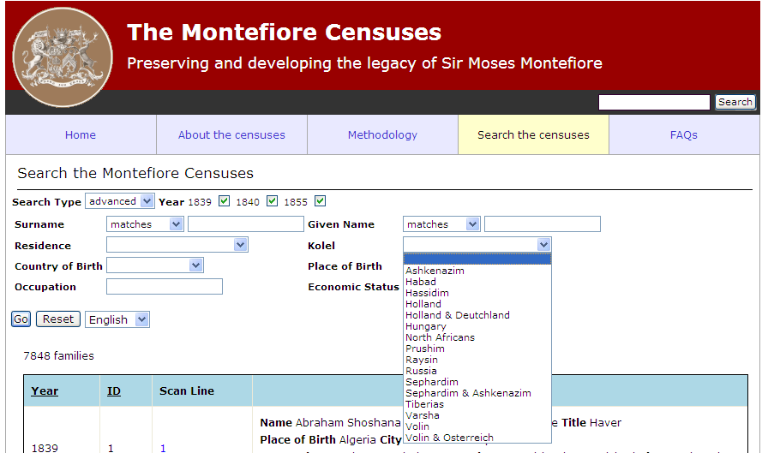
Kolel –
Congregation

Slide 20
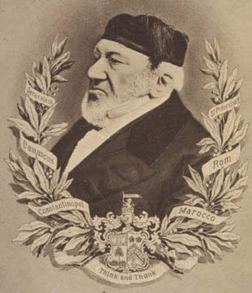
The Jewish community thanks Sir Moses Montefiore for his initiative 183 years ago!

Slide 21
The most comprehensive document of the Jewish community in the 19th century in Palestine.
Other small databases dealing in part with the 19th century in the Israel Genealogy Research Association Collection
Baptisms 1839-1911 Christ Church (809)
Births 1884-1940 Zikhron Ya'akov (3,429)
Burials and Cemeteries 1839-1980 Christ Church (324)
Census Nufus 1886-1916 Palestine – there are in Hebrew (8,211)
Immigration 1882-1917 (329)
Kolel Lists – males only 1889-1932 (2,274)
Marriages of the Jewish community 1847-1934 Syria (2,661)
Marriages and Divorces 1892-1940 Ketubot Sephardic Community Jerusalem (16,506)
Mukhtar Books Jerusalem 1824-1915 (1,459)
Profession 1889-1989 Hebrew Theatre (614)
Residents 1882-1911 Rishon Letsiyon (1,194)
Residents 1898, 1927, 1930 Zikhron Ya'akov (255)

Slide 22
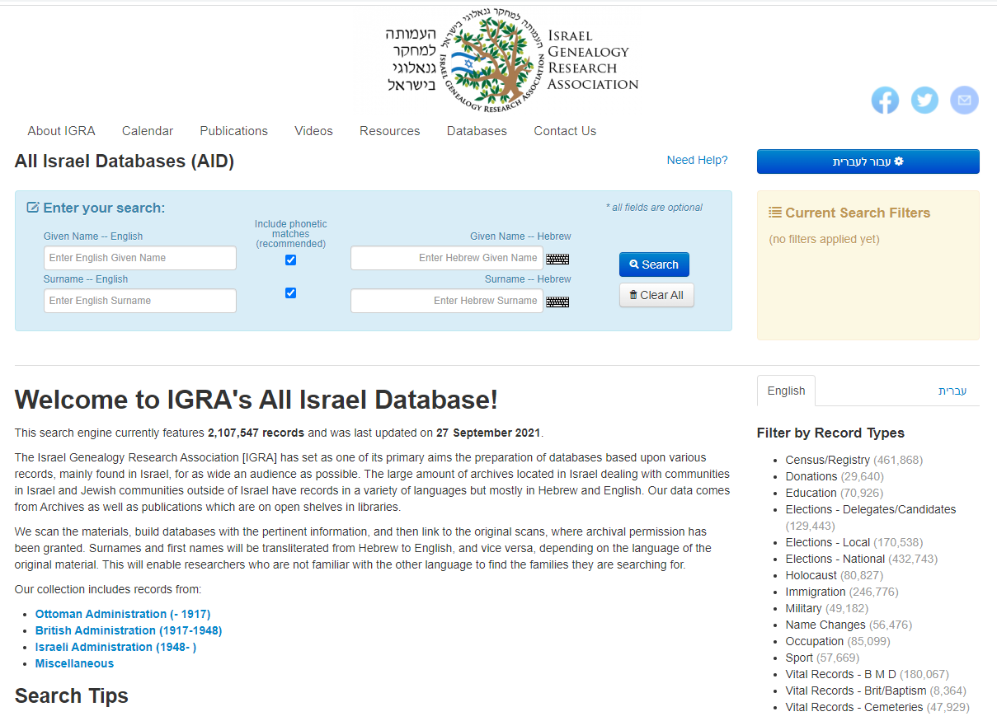

Slide 23
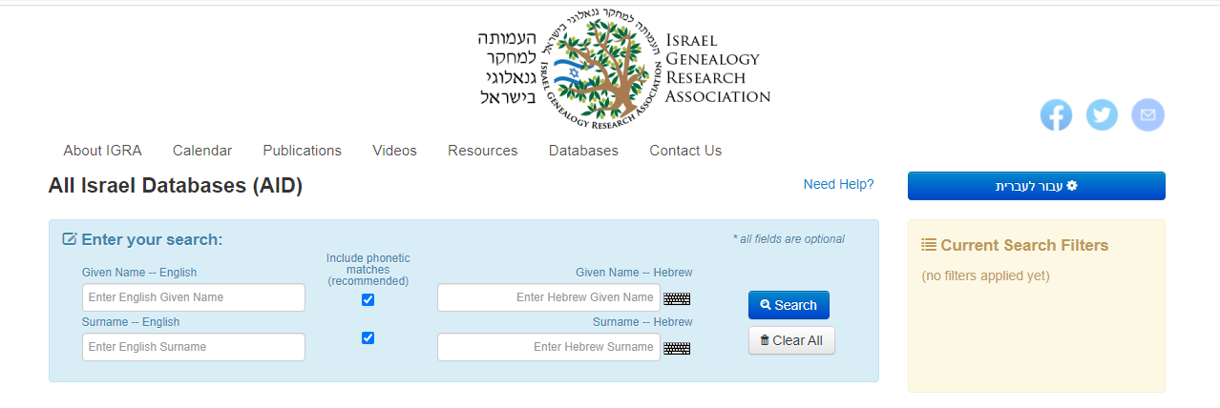
Registering to the website required – free
Phonetic matches or exact search
Virtual keyboard for Hebrew if you don’t have a Hebrew keyboard
Most names are transliterated from the original language (Hebrew & English)
Current Search Filters - shows which search filters you have used to narrow down the original search
https://genealogy.org.il

Slide 24
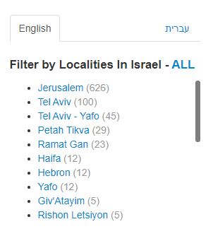
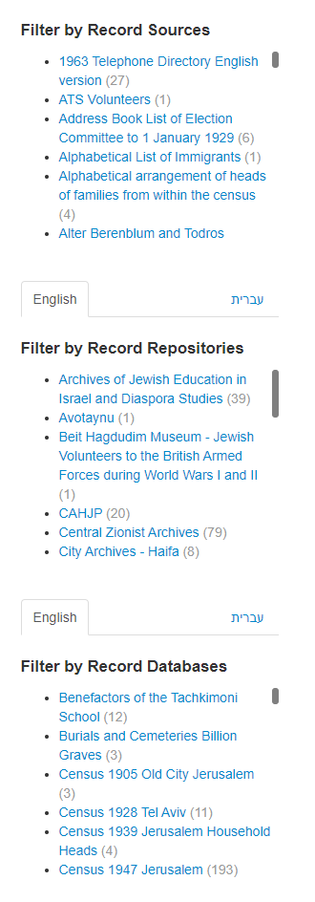
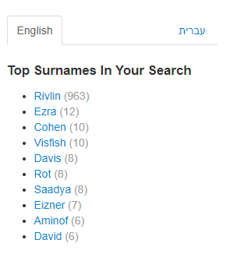
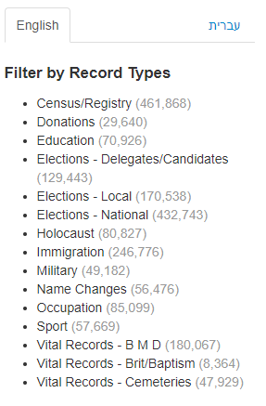
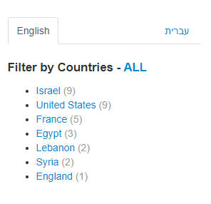
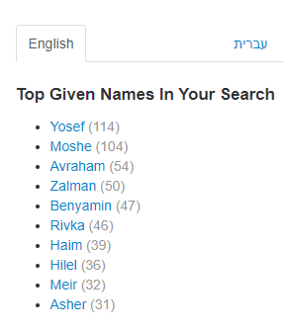
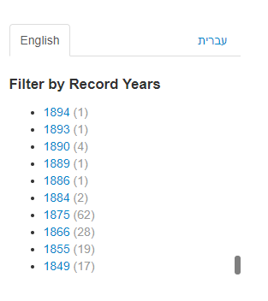
RIVLIN
All the collection

Slide 25


Thank you

