Slide 1
Tracing the Sephardic roots / Siguiendo los pasos de los sefardíes
Rabbi Jordan Gendra-Molina, Ph.D.

Slide 2
The content of this video, as well as the thoughts, views, and opinions expressed herein belong solely to the creator and do not necessarily reflect the views of FamilySearch International and RootsTech.

Slide 3
Goals
Objetivos
Presentation on the most important Sephardic communities around the world and their archives (online)
Presentación de los centros sefardíes históricos más importantes y sus archivos (online)
Updates on archival links
Actulizaciones de las ligas a los archivos
Bibliography / Bibliografía
Malka, J. Sephardic Genealogy: Discovering your sephardic ancestors and their world. Avotaynu; 2009 (2nd ed.)
https://sephardicgen.org/

Slide 4
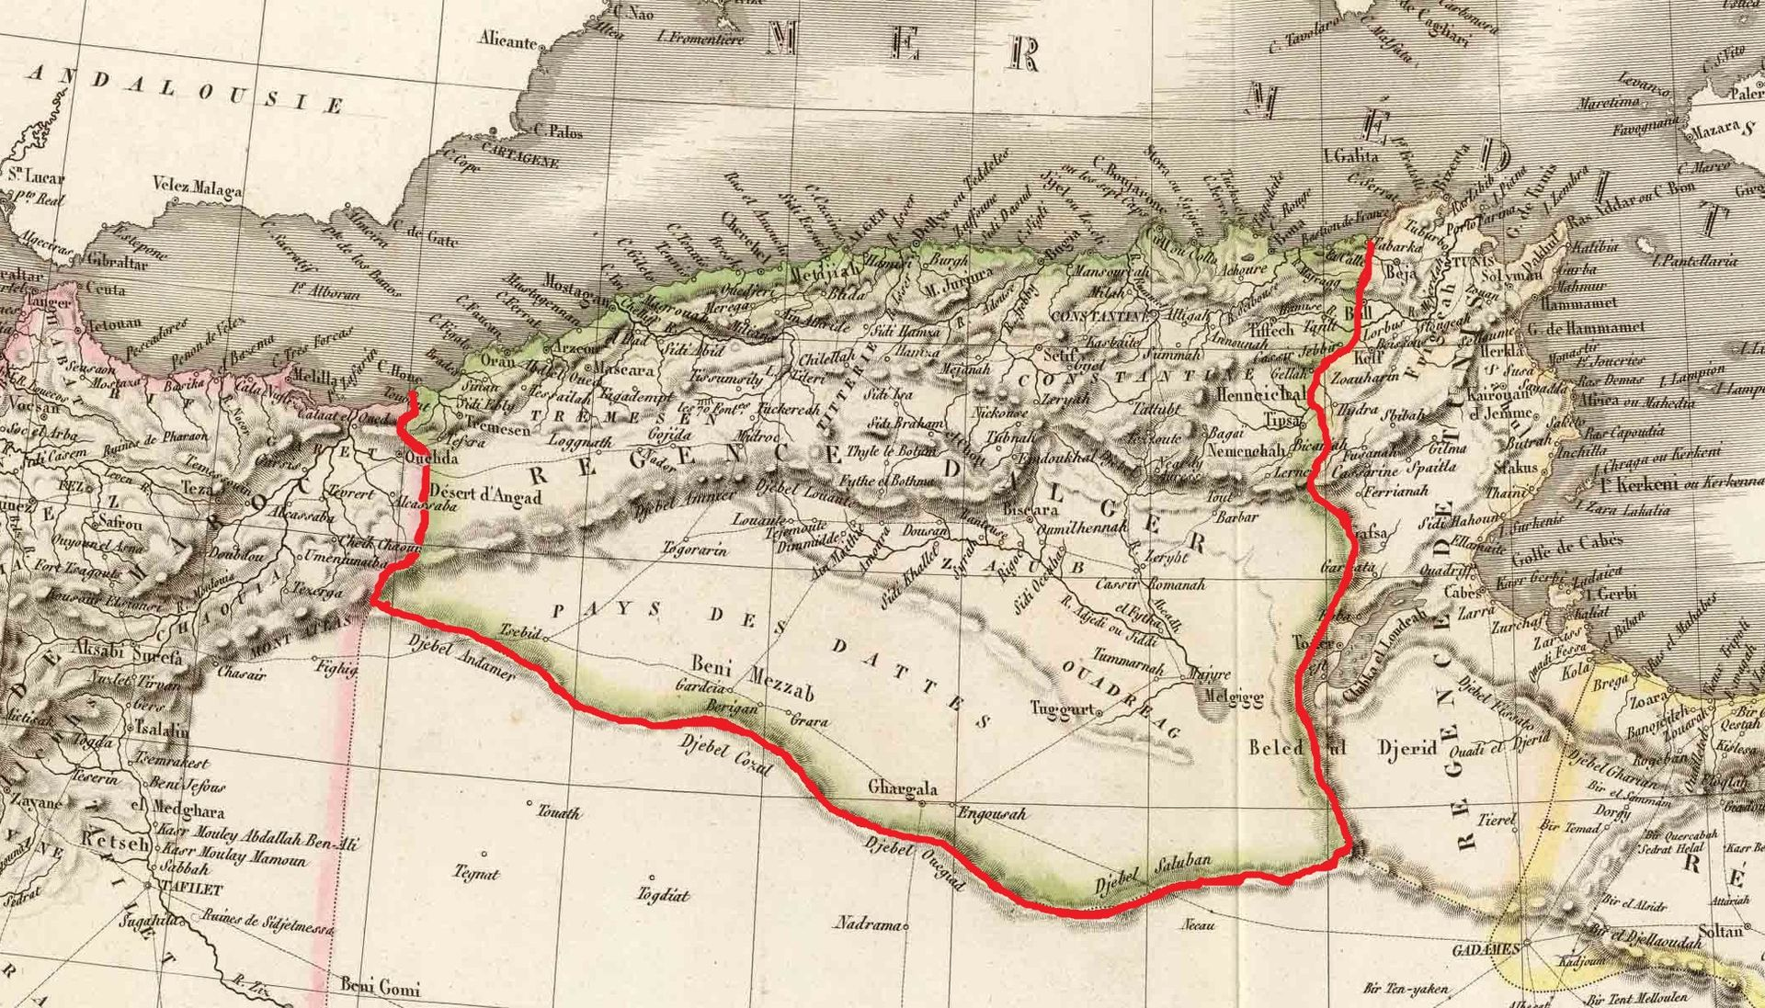
Alger / Algeria
From Ottoman to French – De territorio otomano a departamento francés

Slide 5
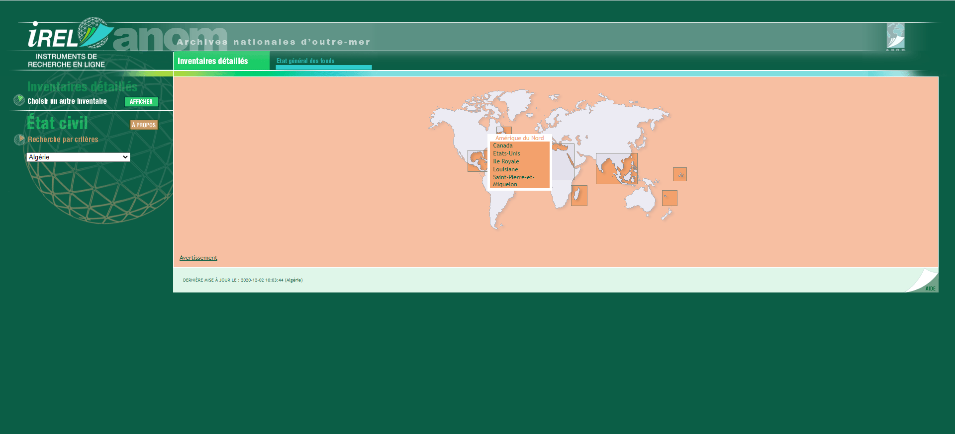
Archives Nationales d’outre-mer http://anom.archivesnationales.culture.gouv.fr/caomec2/

Slide 6
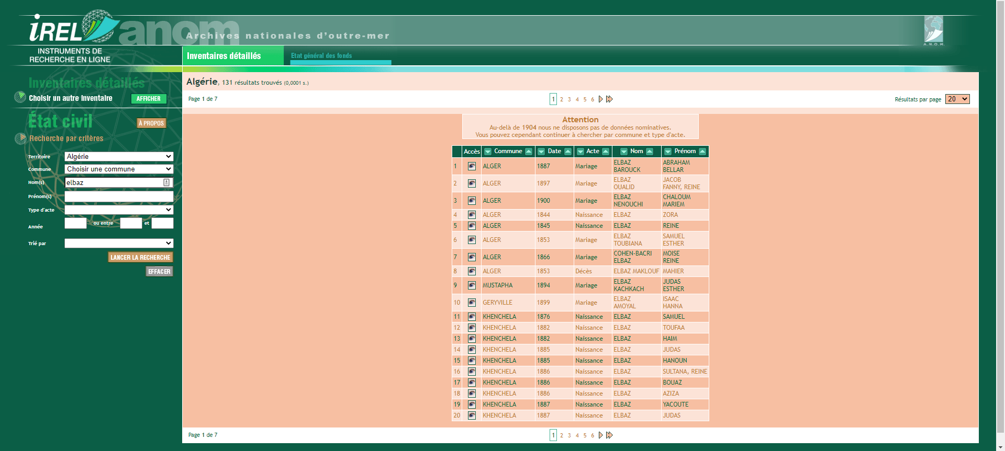
Archives Nationales d’outre-mer http://anom.archivesnationales.culture.gouv.fr/caomec2/

Slide 7
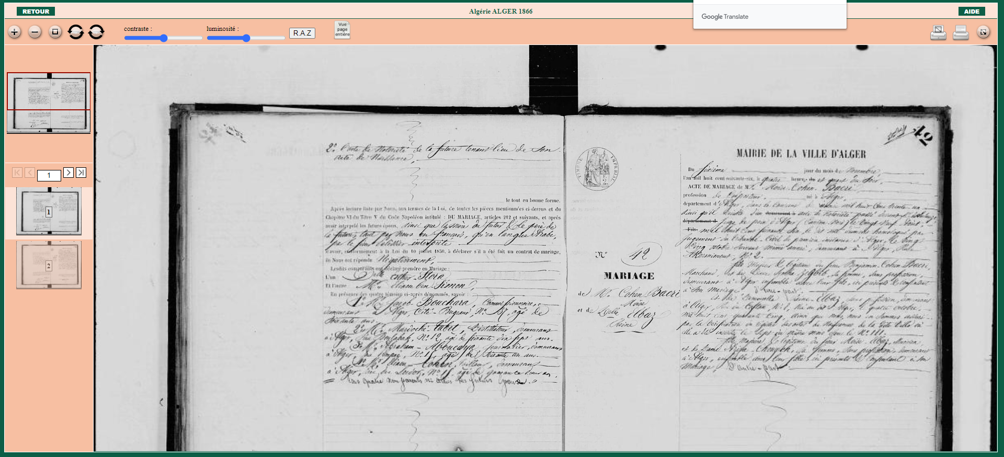
Archives Nationales d’outre-mer http://anom.archivesnationales.culture.gouv.fr/caomec2/

Slide 8
Newspapers
Prensa
Le Moniteur Algérien 1832-1858
Bulletin official du gouvernement general du l’Algérie 1861
L’Écho d’Oran 1840
L’Avenir de l’Est 1901
L’Avenir 1870
Le Journal de Constantine 1848
Le Progrès de l’Algérie 1850

Slide 9
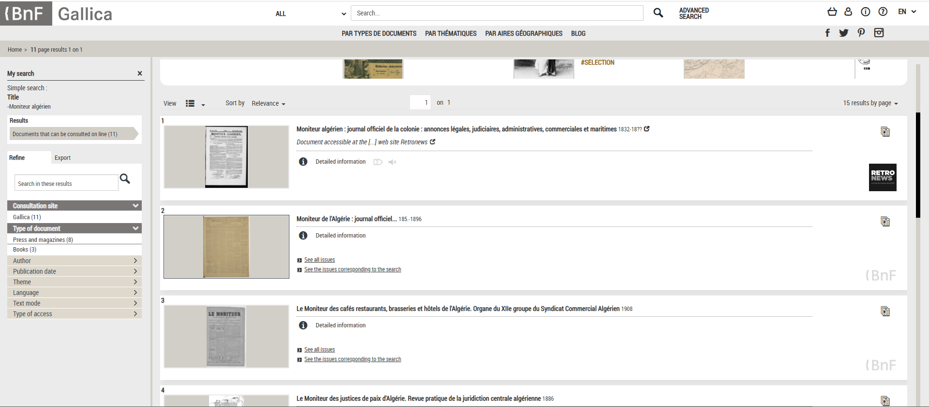
Newspapers
Prensa https://gallica.bnf.fr/accueil/en/content/accueil-en?mode=desktop

Slide 10
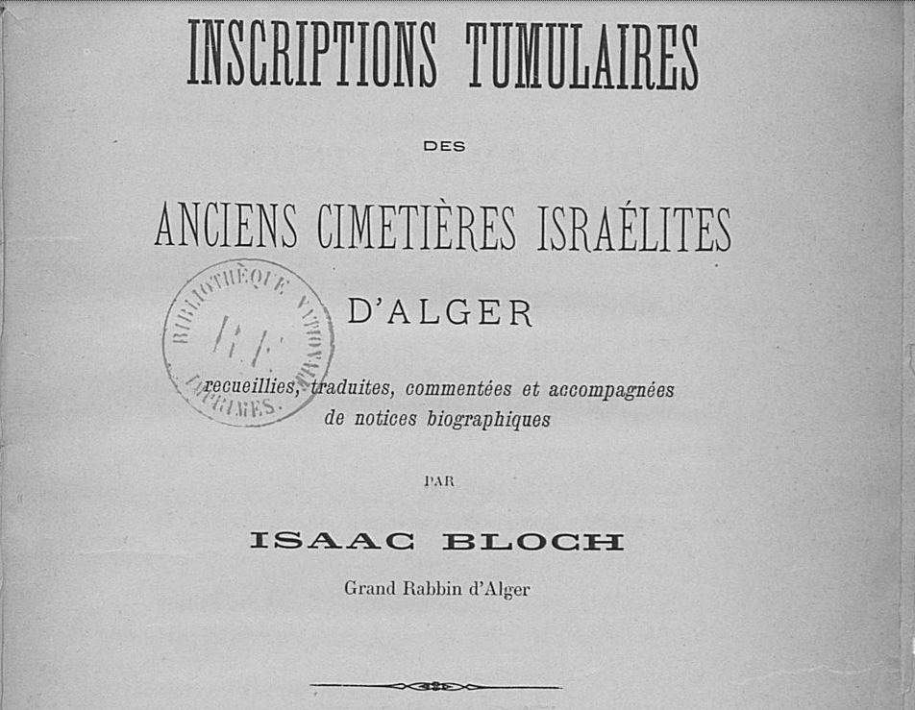
Isaac Bloch
Inscriptions Tumulaire des Anciesn Cimetèries Israélites d’Alger https://gallica.bnf.fr/accueil/en/content/accueil-en?mode=desktop

Slide 11
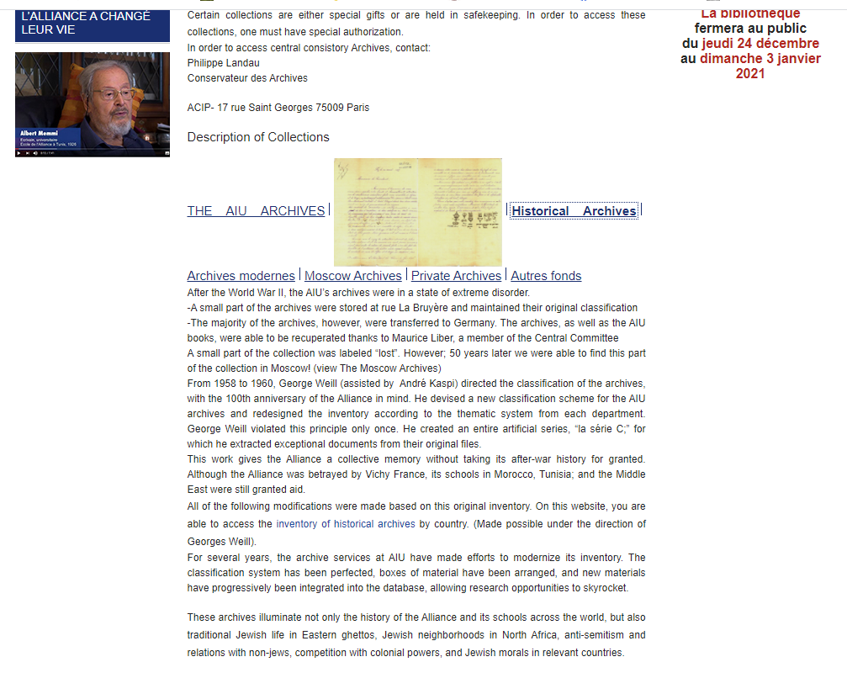
L’Alliance Israélite Universelle
Archives http://www.aiu.org/en/archives-0

Slide 12
Other archives
Otros archivos
Weddings / matrimonios Algeria - Sinagogue Berit Shalom Paris
Constantine Jewish Community / Communidad Judia de Constantina (1795-1960)
http://cahjp.nli.org.il/
Consistoire Central de Juives de France, Paris

Slide 13
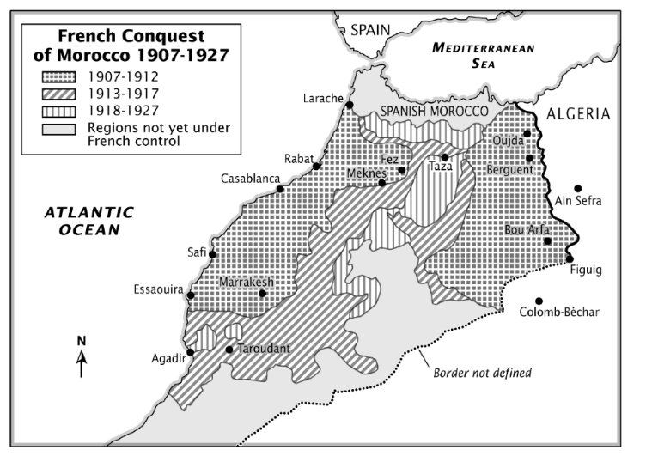
Morroco / Marruecos

Slide 14
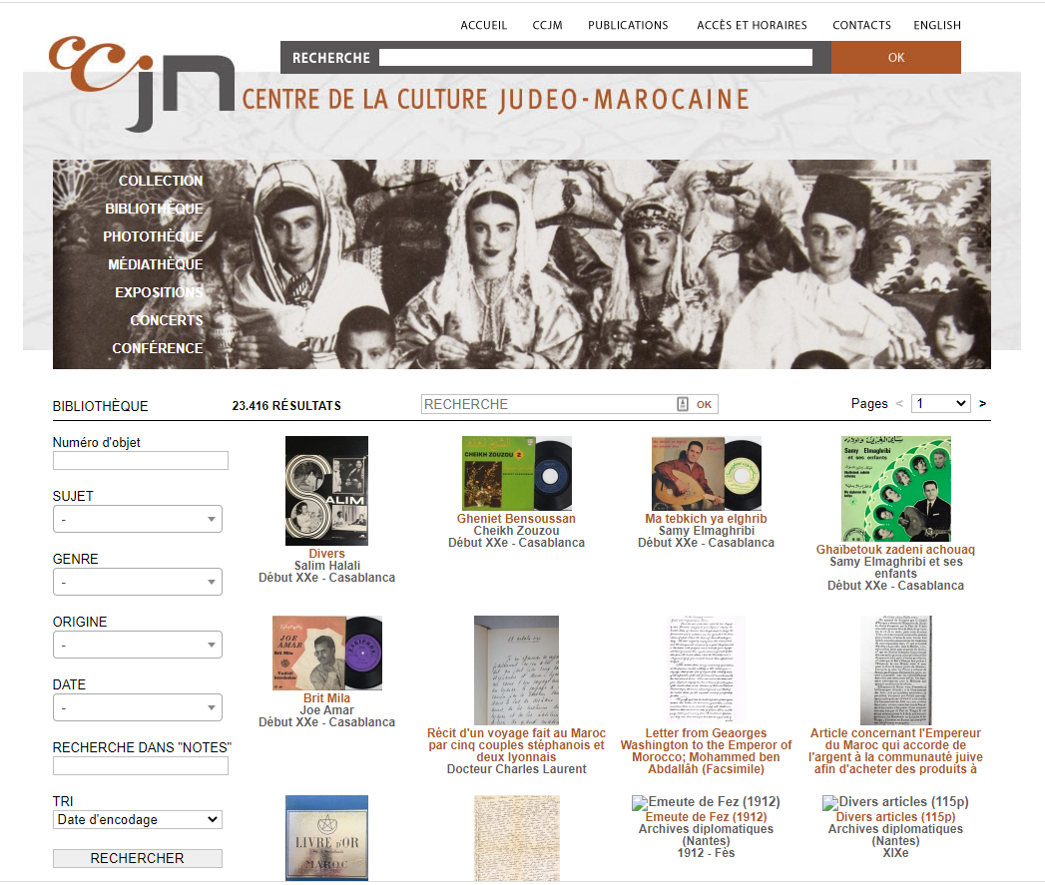
Centre de la Culture Judeo-Maroicaine https://www.judaisme-marocain.org/bibliotheque

Slide 15
Other Archives
Otros Archivos
Brit Milah register / Registro de circuncisiones
Rabino Vidal haSarfati Tetuan (1881-1920)
http://www.culturaydeporte.gob.es/msefardi/en/colecciones/catalogos-online.html
Jewish Cemetreries / Cementerios Judíos
https://www.beit-hahayim-tanger.com/
http://www.cimetierejuifcasablanca.com/site/
http://www.cimetierejuifmarrakech.com/
http://www.cementeriojudiotetuan.org/
Press / Prensa
La liberté (www.gallica.bnf.fr)

Slide 16
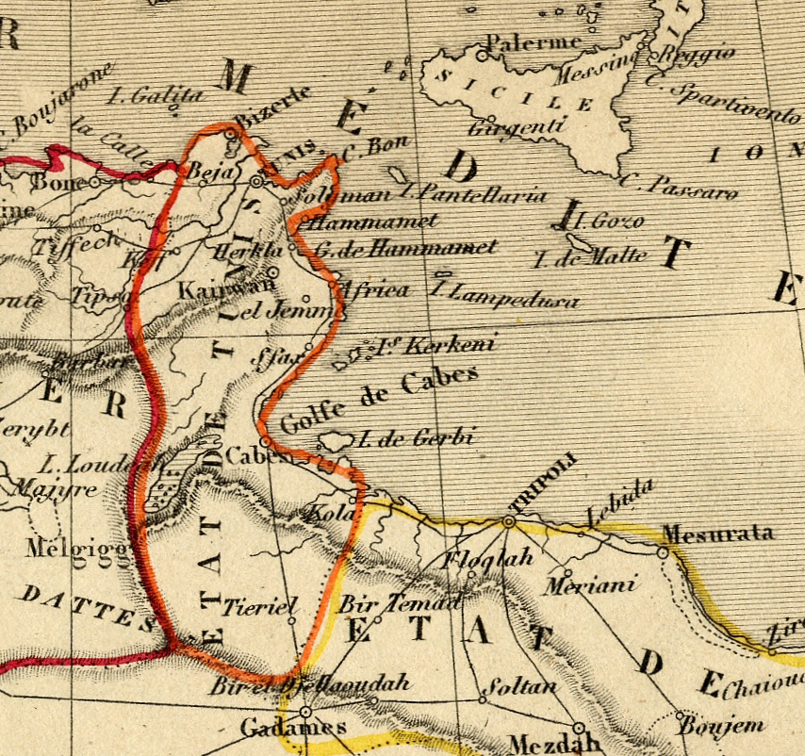
Tunisie / Túnez

Slide 17
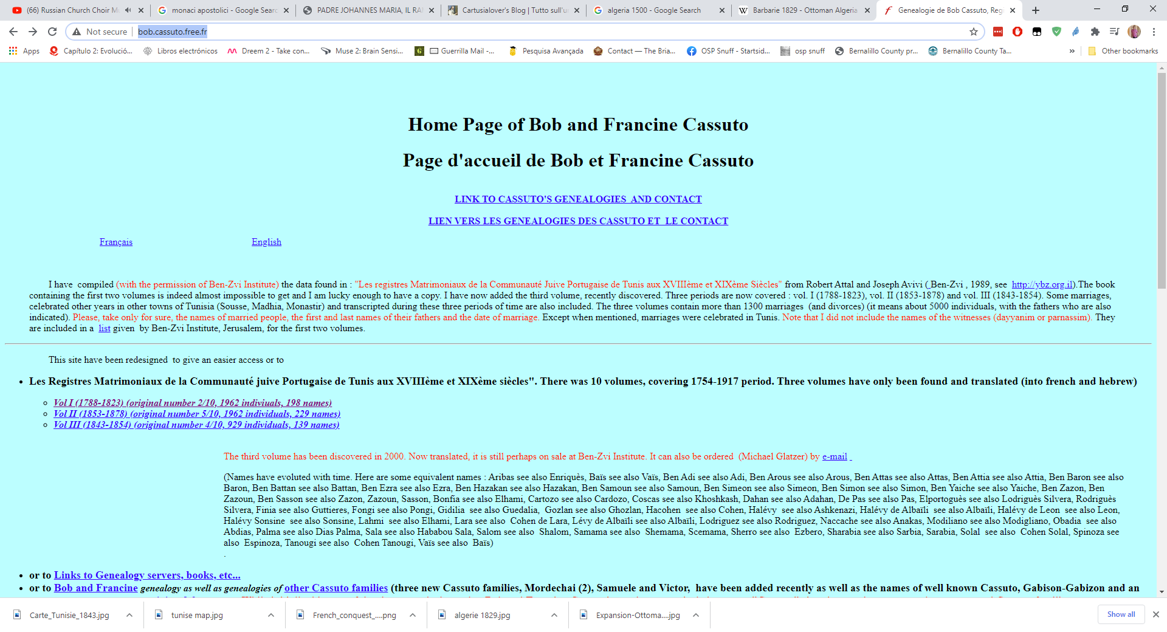
Ketubot
Les Registres Matrimoniaux de la Communauté juive Portugaise de Tunis aux XVIIIème et XIXème siècles (1754-1917) http://bob.cassuto.free.fr/

Slide 18
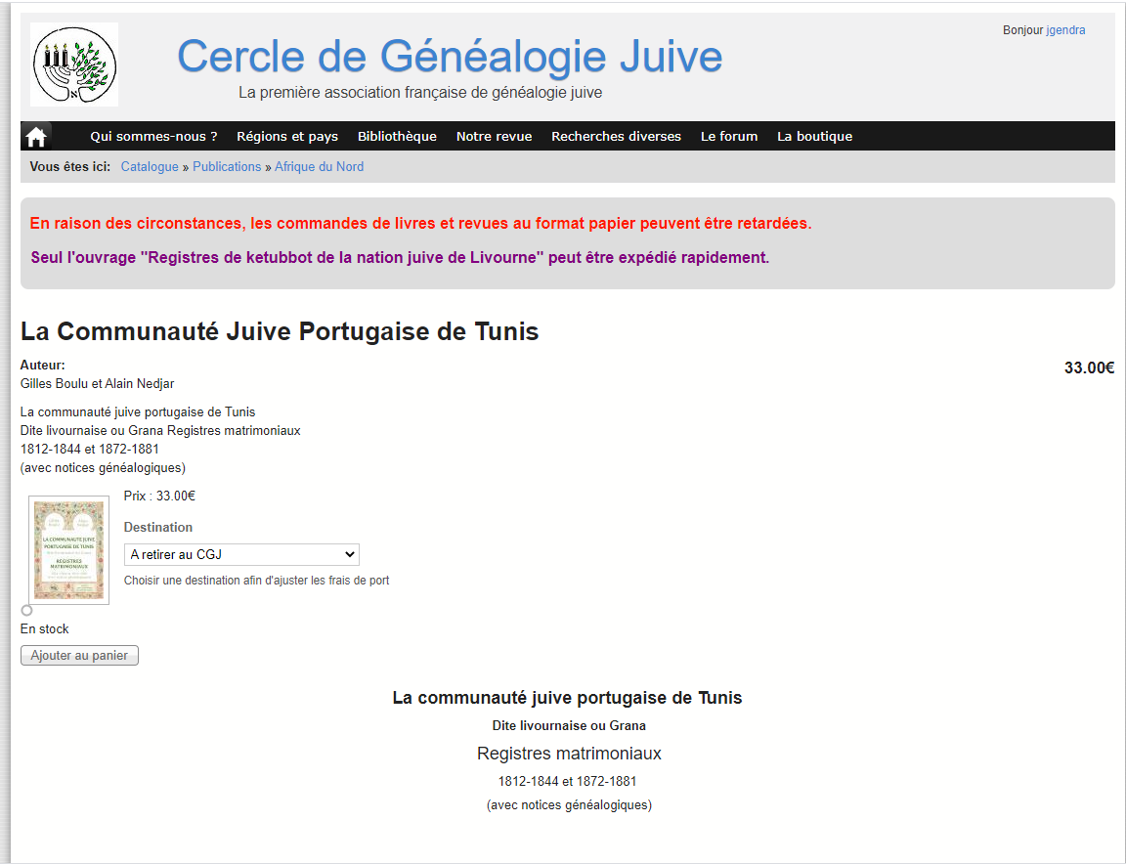
Ketubot
Cercle de Généalogie Juive

Slide 19
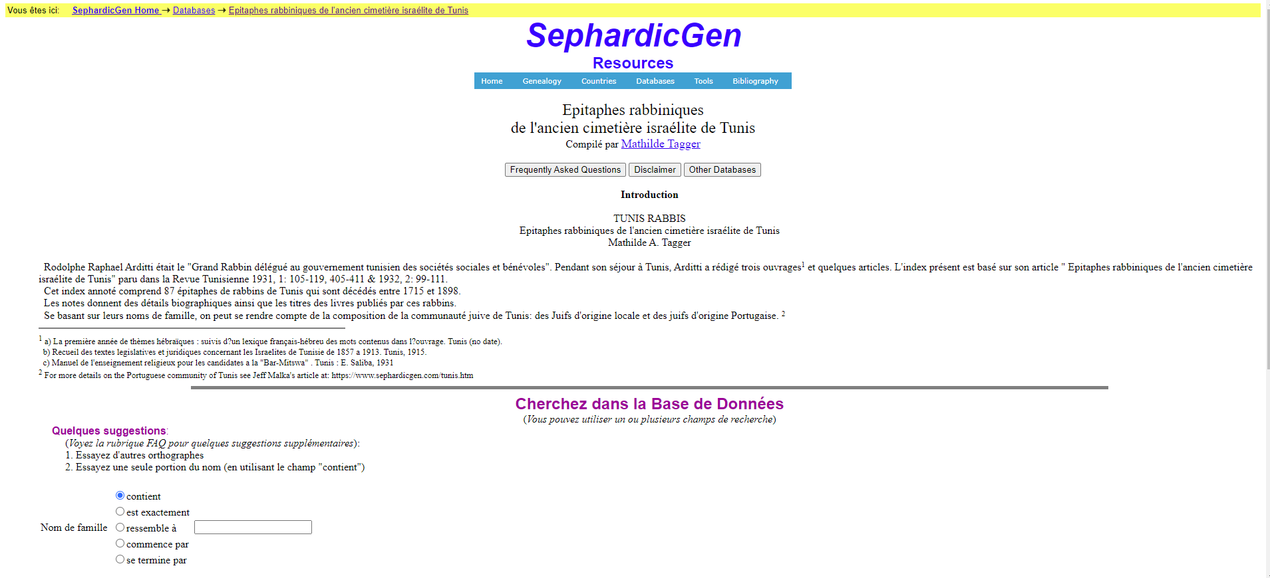
Cemintiere Elie Borgel – Tunis (1894)
R. Rafael Arditti: Epitaphes rabbiniques de l'ancien cimetière israélite de Tunis. Revue tunisienne, 1931-1932 https://www.sephardicgen.com/databases/TunisRabbisSrchFrmFR.html

Slide 20
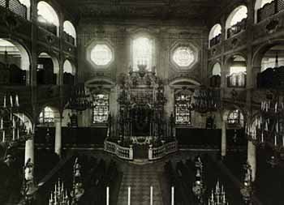
Livorno - Italia
1593 – Ferdinand I de Medici opens the city to Jews to worship according to their religions. Many members of the community settled in Tunis around 1700, calkled Granna
1665-1802 Register of Ketuvot avaiable
http://cahjp.nli.org.il/content/livorno-jewish-community-and-organizations
List of Jews allowed to reside in Livorno (1753-1807) can be found at Jean Pierre Filippini, Il Porto di Livorno e la Toscana (1676-1814); University of Michigan. 1998.
Notaries - https://www.archiviodistato.firenze.it/archividigitali/cerca/

Slide 21
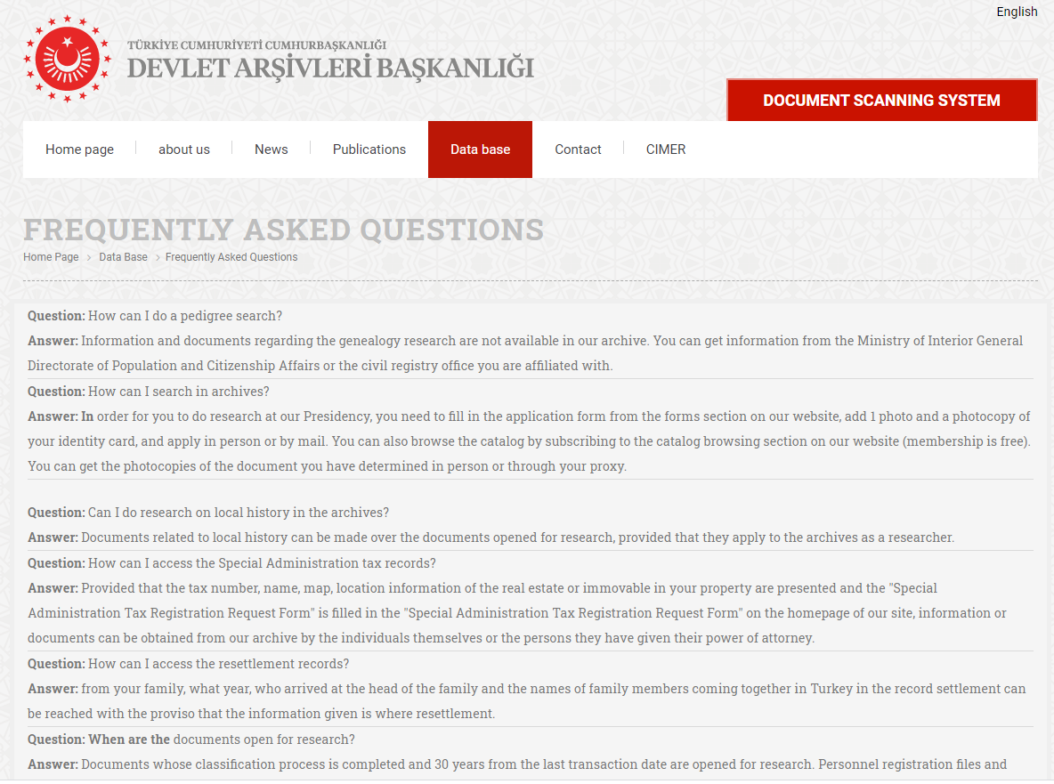
Ottoman Empire Imperio Otomano
Turquía / Turkey
Basbakanlik Arsivi – National Archives / Archivo Nacional

Slide 22
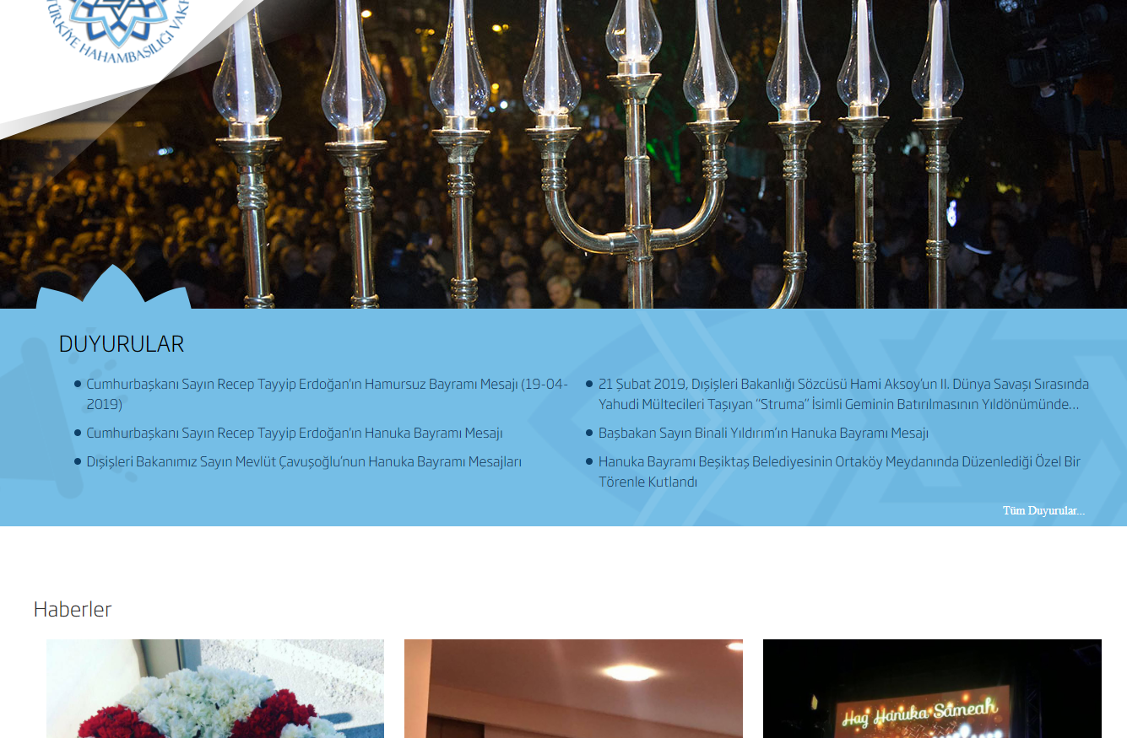
Ottoman Empire Imperio Otomano
Turquía / Turkey

Slide 23
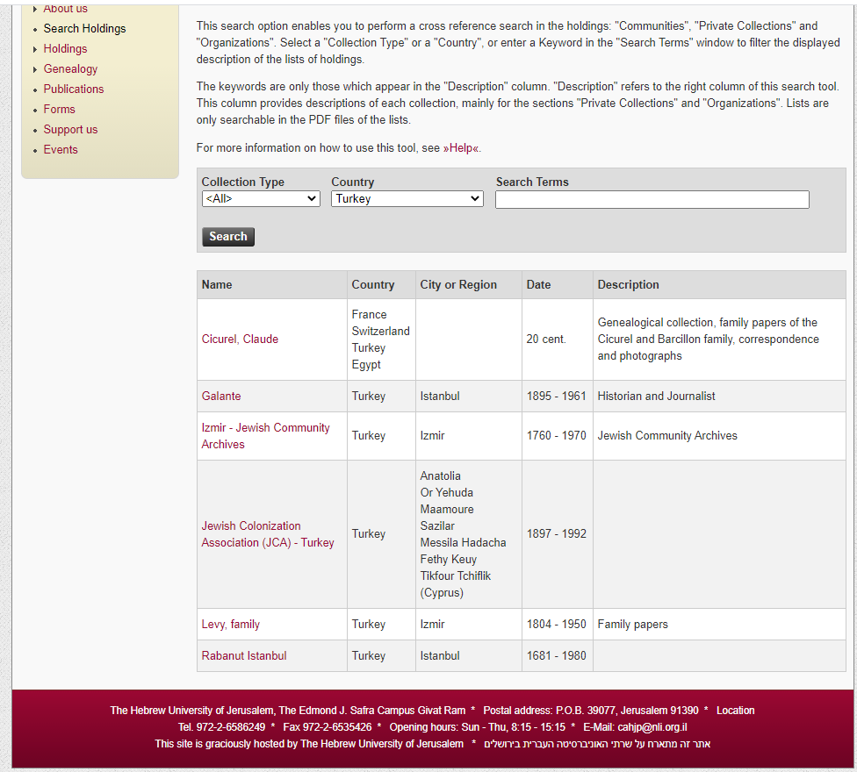
Ottoman Empire Imperio Otomano
Turquía / Turkey http://cahjp.nli.org.il/search-holdings

Slide 24
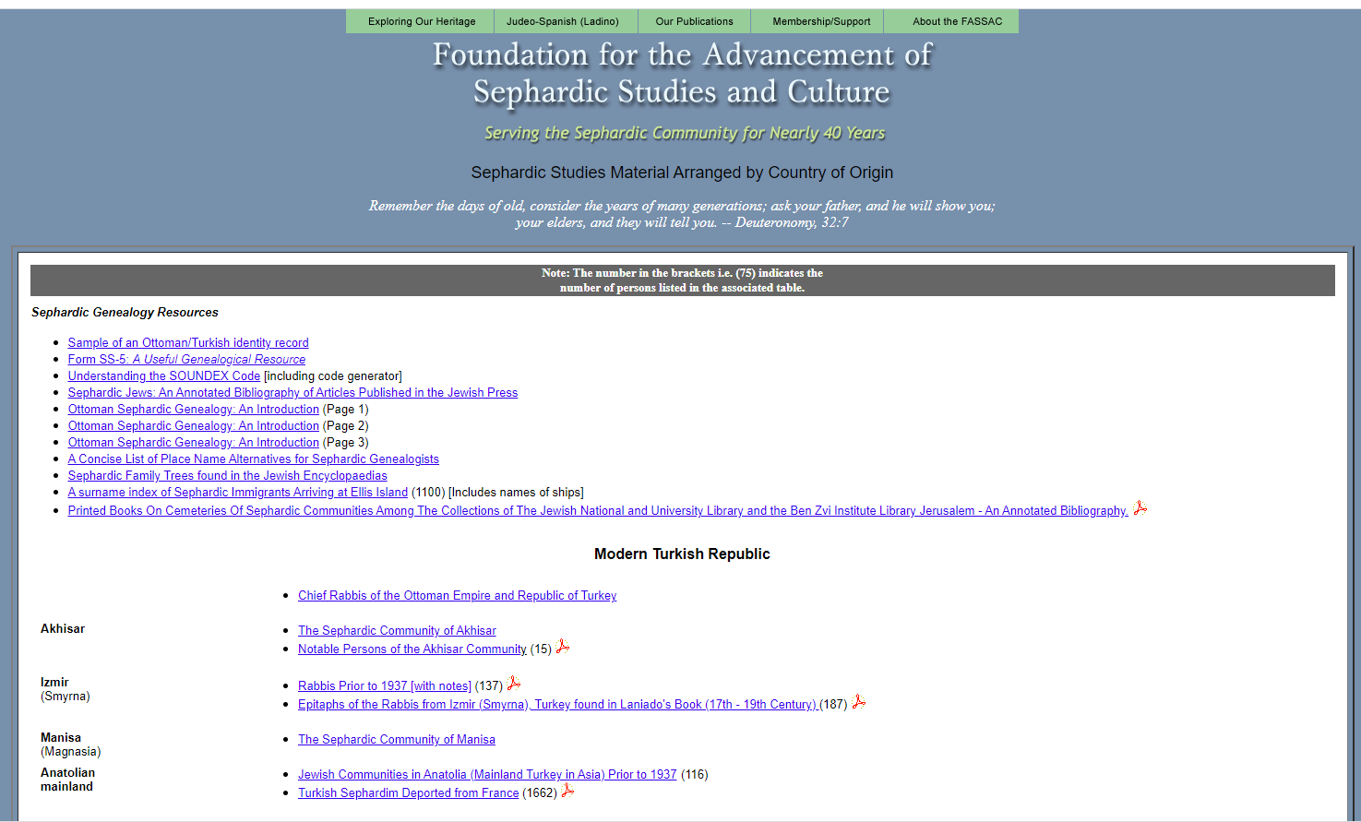
Ottoman Empire Imperio Otomano
Turquía / Turkey www.sephardicstudies.org

Slide 25
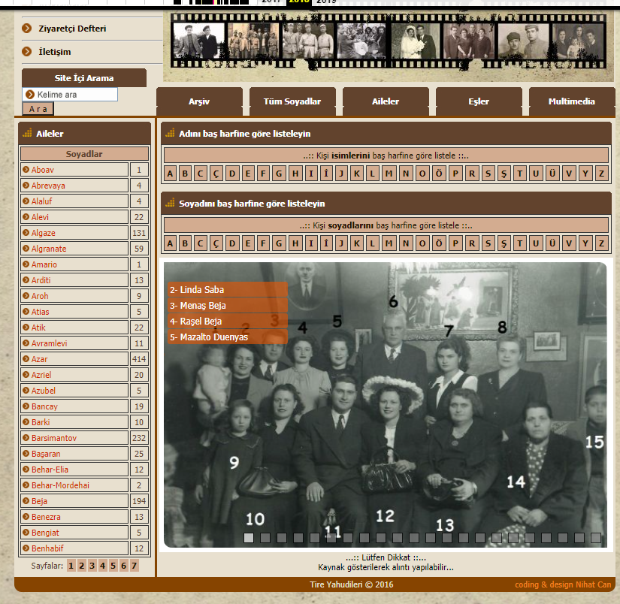
Ottoman Empire Imperio Otomano
Turquía / Turkey http://tireyahudileri.com/ https://web.archive.org/

Slide 26
Ottoman Empire Imperio Otomano
Turquía / Turkey
Press / Prensa
Press / Prensa
La Boz del Pueblo (Izmir)
La Epoca (Salonika)
Archivos consulares / Consulat files
Italia / Italy
Registri dei nazionali
Francia / France
Archives diplomatiques
https://www.diplomatie.gouv.fr/fr/archives-diplomatiques/informations-pratiques/site-de-nantes/
BIII 290 – Salonique et allieurs
España / Spain

Slide 27
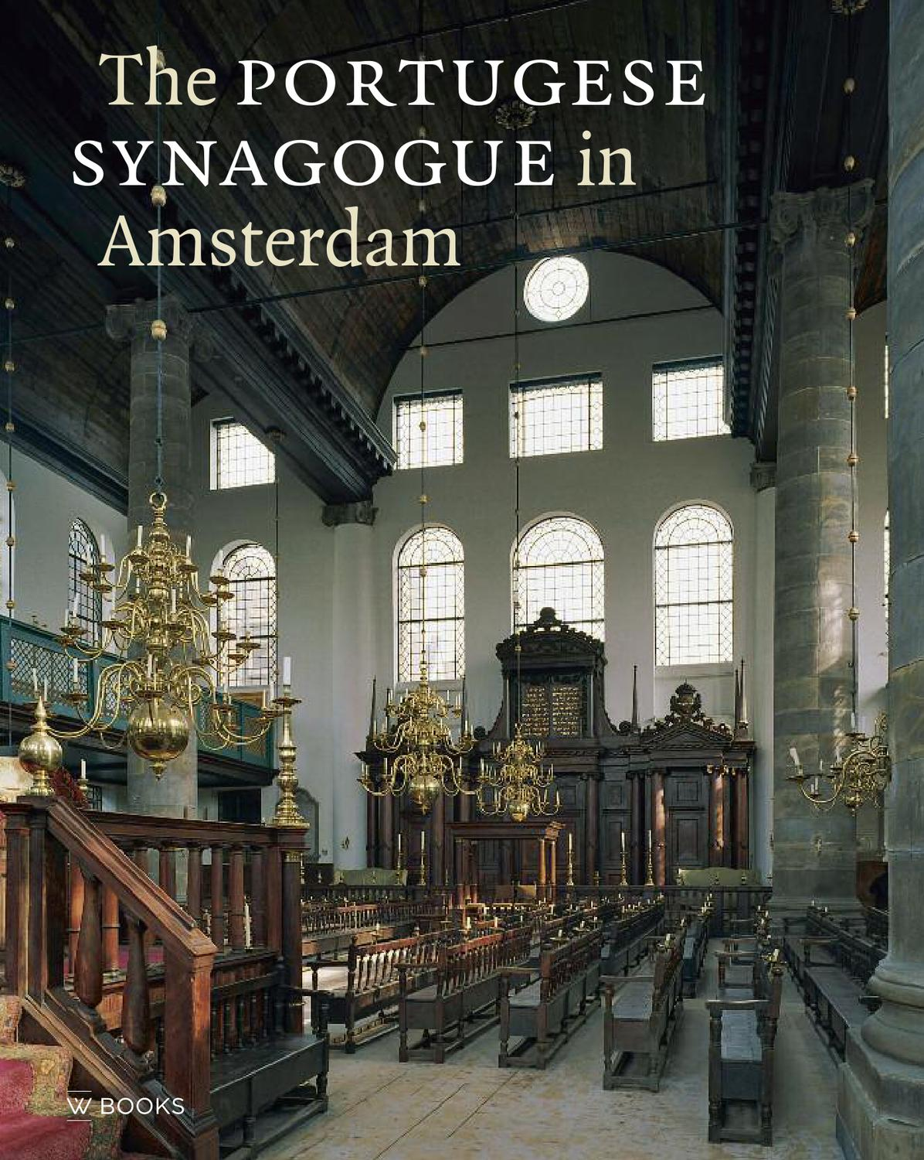
Amsterdam -
Kahal Kadosh Talmud Torah https://archief.amsterdam/
1500s – Arrival to Amsterdam and Hambrug (Germany)
1600s – The Jews expands to Dutch colonies Curaçao and Suriname.
In Amsterdam the 3 Sephardic congregations joined into 1 called Kahal Kadosh Talmud Torah.
XVI – Llegada de los Sefardíes a Amsterdam and Hamburg (Alemania)
XVII – Presencia sefardí en las colonias holandesas Curaçao y Suriname.
XVIII- Las 3 congregaciones sefardíes de Amsterdam se unen en una sola llamada Kahal Kadosh Talmud Torah.

Slide 28
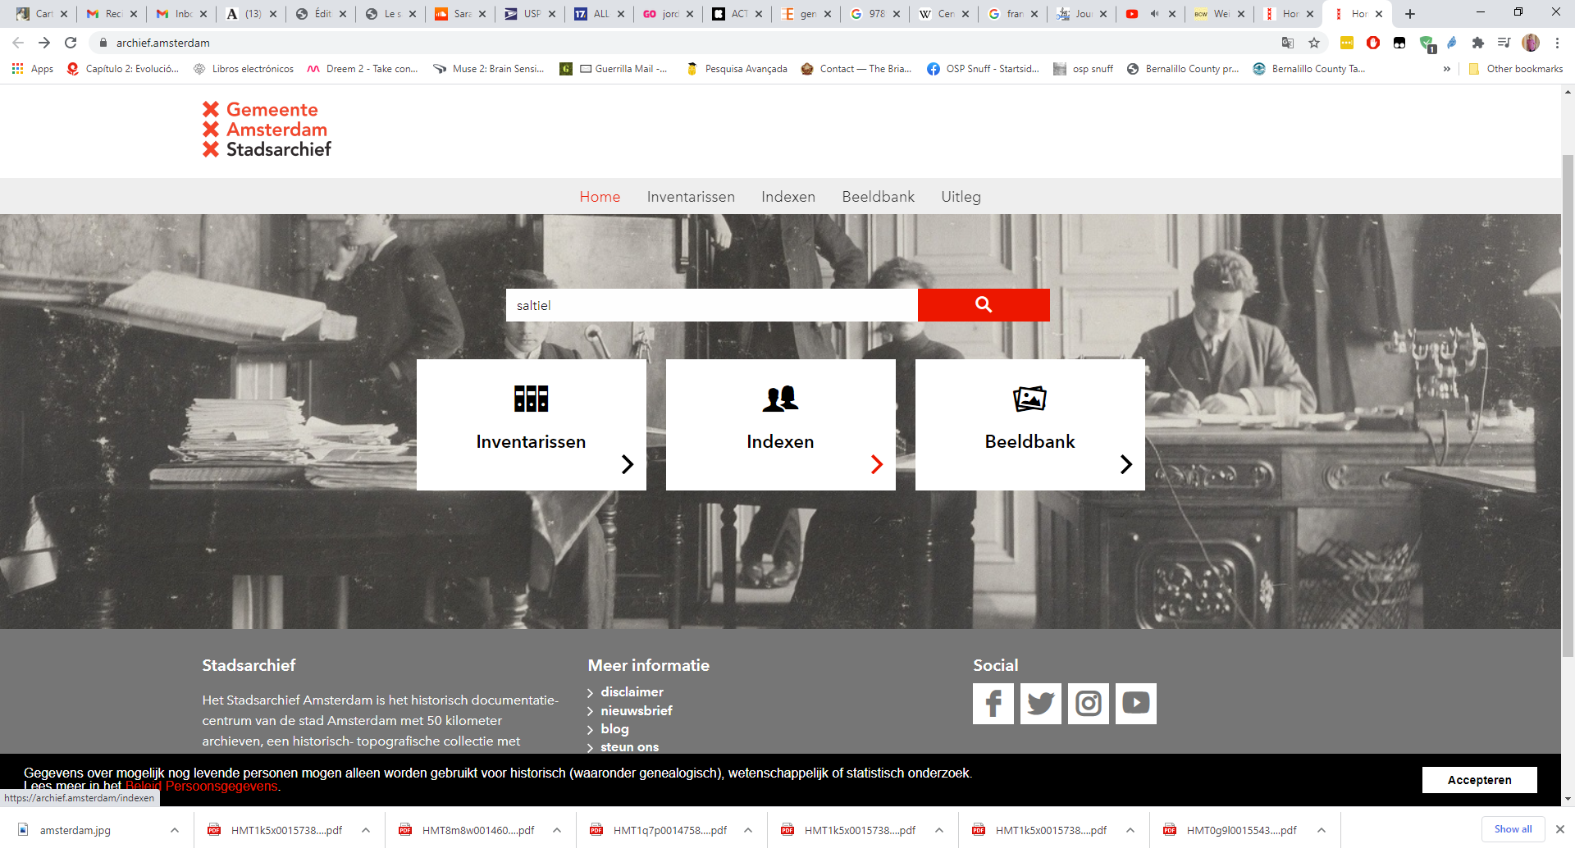
Amsterdam -
Kahal Kadosh Talmud Torah https://archief.amsterdam/

Slide 29
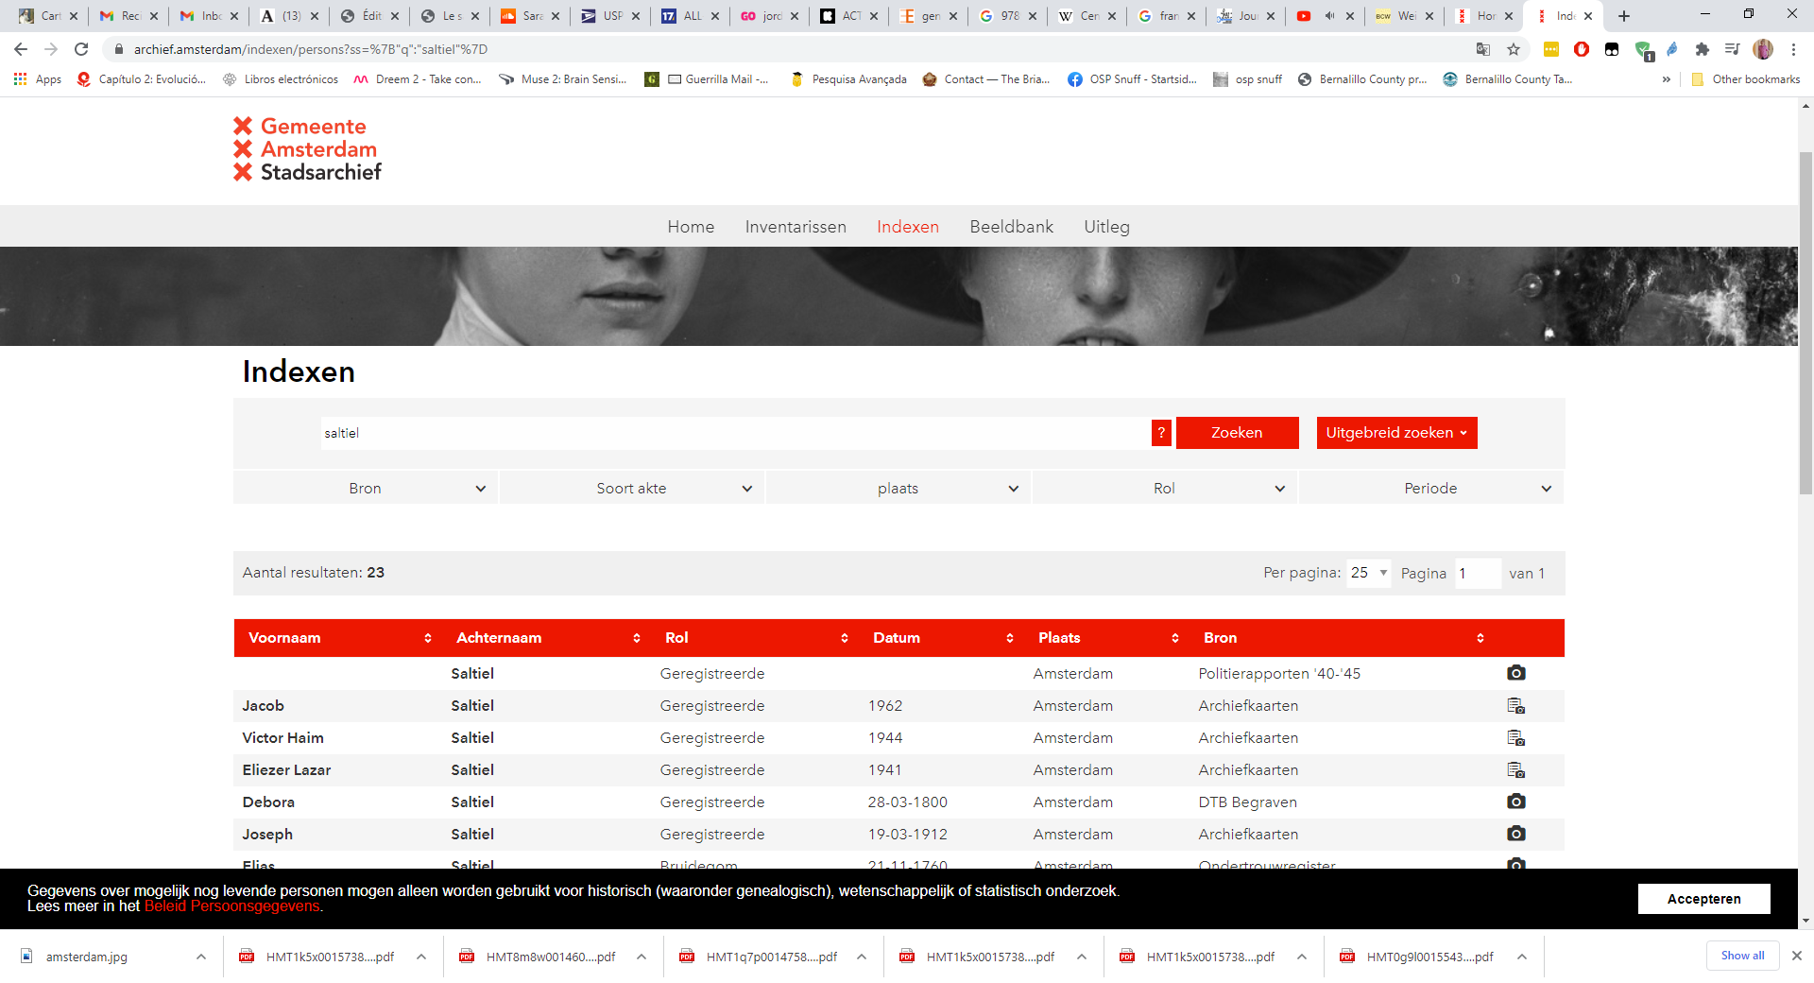
Amsterdam -
Kahal Kadosh Talmud Torah https://archief.amsterdam/

Slide 30
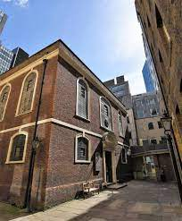
London – Beavis Mark
1701 – Built the present building.
1701 - Se construye el edificio actual.
London Metropolitan Archives
(Burials, marriages and circumcisions / Entierros, matrimonios y circuncisiones)
https://search.lma.gov.uk/LMA_Doc/Lma_4521.pdf
Matrimonios / Marriages
(1689-1700) https://www.sephardicgen.com/databases/KetubotWrittenByHakhamAylionSrchFrm.html
(1701-1900)
https://www.sephardicgen.com/databases/BevisMarriagesSrchFrm.html

Slide 31
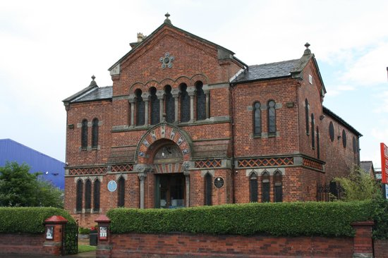
Manchester (UK)
1800 – Manchester welcomes sephardic Jews. The portuguese synagogue is today the Jewish Museum.
XIX – Manchester acoge a una comunidad sefardí. Hoy el edificio de la sinagoga portuguesa alberga el Museo Judío.
Morris L. Bierbrier, The Sephardim of Manchester- Pedigrees and Pioneers. Shaare Shamayim, 2006.

Slide 32
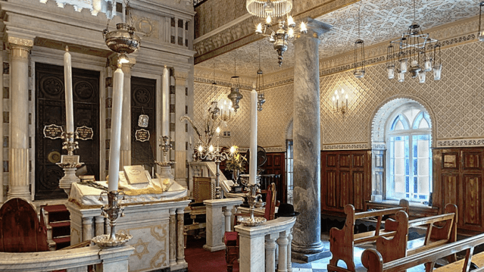
Gibraltar (UK)
(1) La Esnoga Grande (2)Esnoga chica (3) Nefusot Yehuda https://www.nationalarchives.gi/Inhabitants.aspx
After the Sapnish succession war (1710 – 1714) Gibraltar becomes UK territory. Sephardic Jews are allowed to settled immediately with the approval of Kinf of Morroco.
Después de la Guerra de Sucesión Española (1710-1714), el peñón pasa a ser de titularidad británica. La presencia sefardí se inicia entonces con el beneplácito del rey de Marruecos

Slide 33
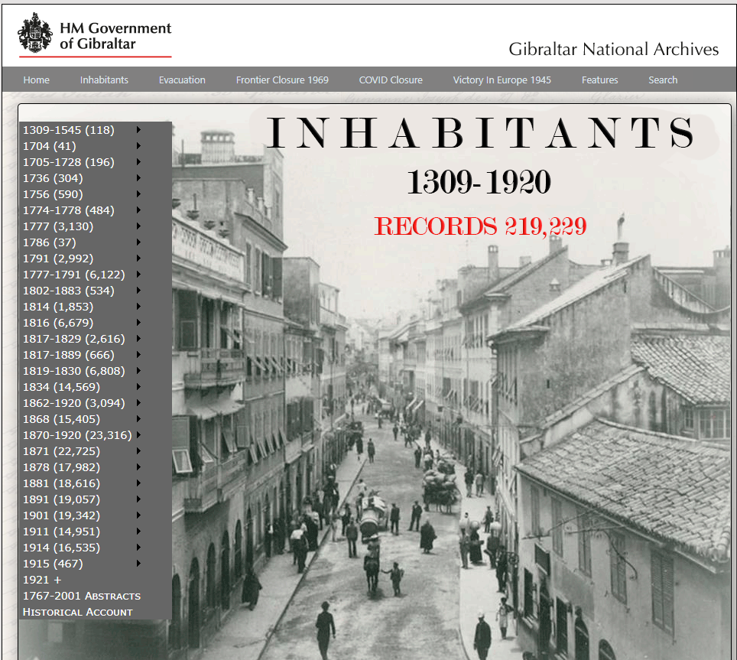
Gibraltar (UK) https://www.nationalarchives.gi/Inhabitants.aspx
José María Abecassís Genealogía Hebraica: Portugal e Gibraltar XVII a XX. (available / consultable: https://catalog.hathitrust.org/Record/101937355)

Slide 34
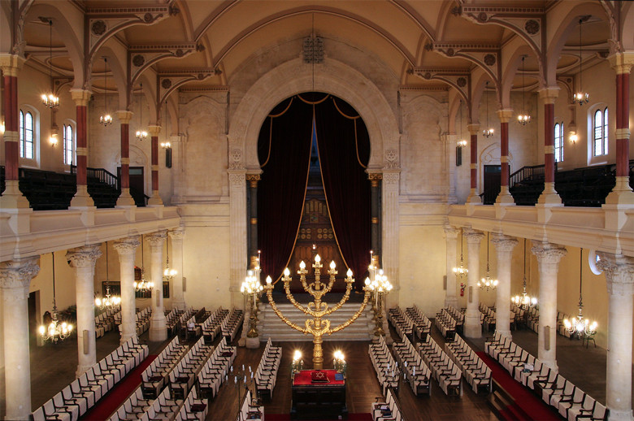
France / Francia
Bordeaux / Burdeos
Bayonne/ Bayona
1790- Jews from Portuguese origin Mendes, Rodrigues, Nunhes, Pimentel, etc.
Comunidad de origien Portugués como atestiguan los apellidos
Records since 1618 at the archivies of La Gironde and municipal archives in the área.
Jean Cavignac, Dictionnarie du Judaïsme bordelais. Archives départementales de la Gironde;1987.
1700s Registers and taxation documents are housed at the archive in Bayonne and at the Dept. Pyrénées-Atlantiques
Circumcision 1725-1773 Accesible at https://www.persee.fr/doc/hispa_0007-4640_1974_num_76_1_4144

Slide 35
France / Francia
Nice / Niza
Marseille / Marsella
Gildas, Bernard. Les Familles juives en France. 16e siècle-1815. Guide des recherches biographiques et généalogiques. Archives Nationales; 1990.
Nice / Niza – Italian territory from 1388 to 1792, when it became French territory. The Jewish population comes from Oran (Argelia)
Fue territorio italiana de la casa de Saboya de 1388 hasta 1792, cuando pasó a ser parte de la República Francesa. La mayoría de la población sefardí proviene de la región argelina de Orán.
Archives from 1814 to 1860 “Fonds Sarde” (Lang. Italian)
https://www.departement06.fr/expositions-et-publications/instruments-de-recherches-2898.html
Marseille / Marsella – Main harbor in the Mediterranean. Most of the Sephardic population comes from Argelia and North Africa.
El principal puerto francés en el Mediterráneo. La mayoría de la población sefardí proviene de Argelia y el norte de Africa.
Archives – Although Jews are documents since the 13th century the main body of information comes from de 1700s forward.

Slide 36

Rabbi Jordan Gendra-Molina, Ph.D. rabbi.gendra
@gmail.com
505-585-1639

