Slide 1
RootsTech 2022
Using Keywords to Demystify Old Catholic Church Records in Filipino Genealogy
David John Paul Sanglap
@istoryadorngpamilya

Slide 2
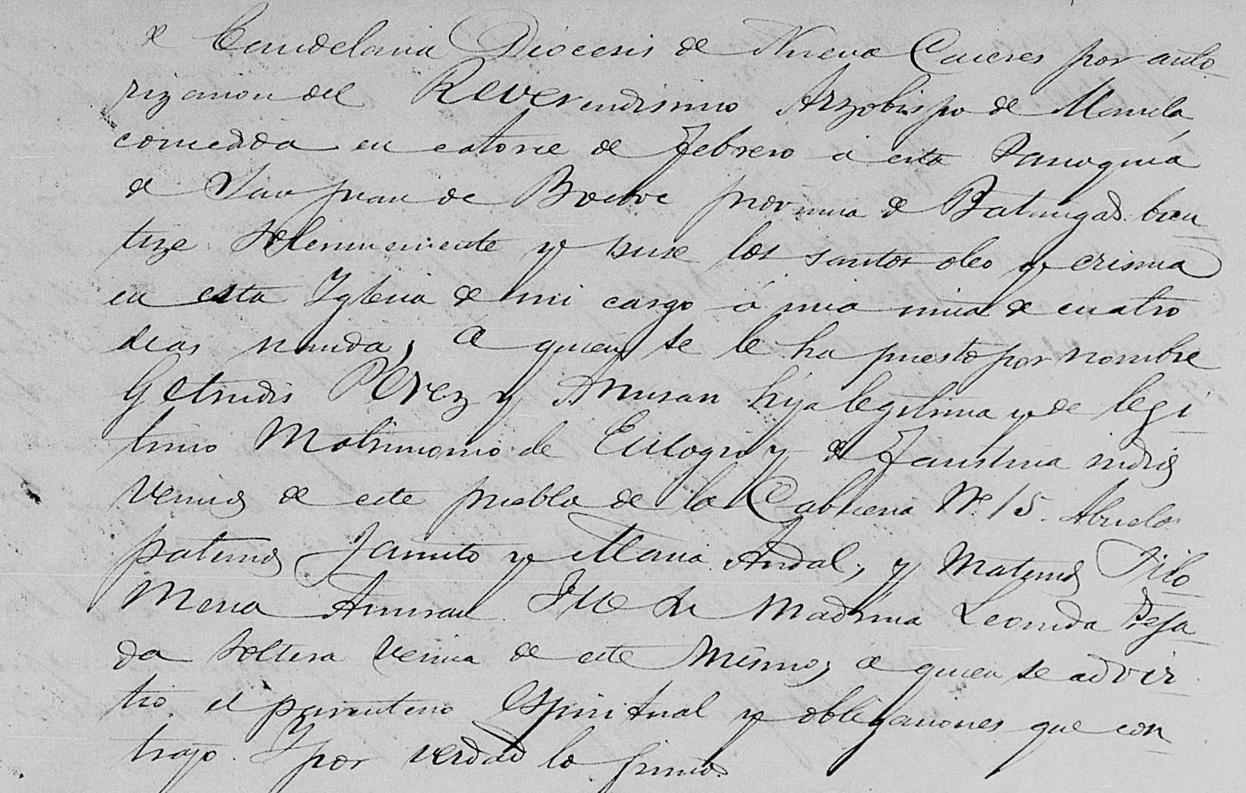
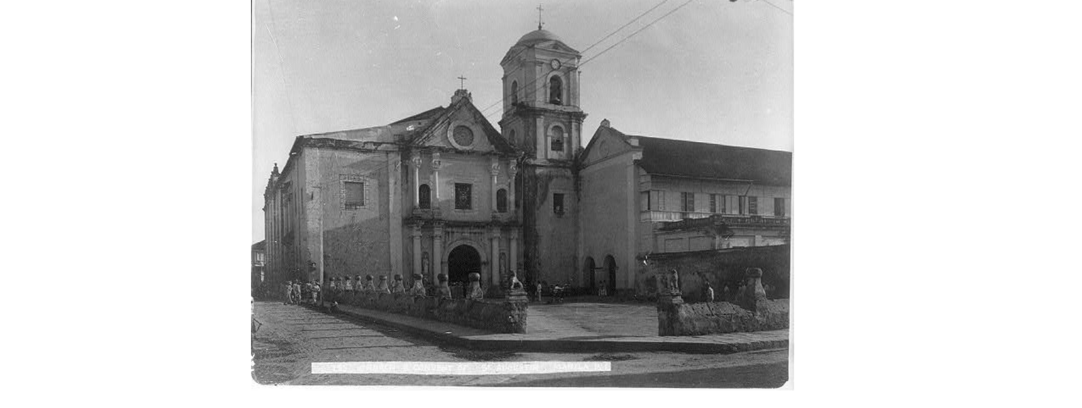
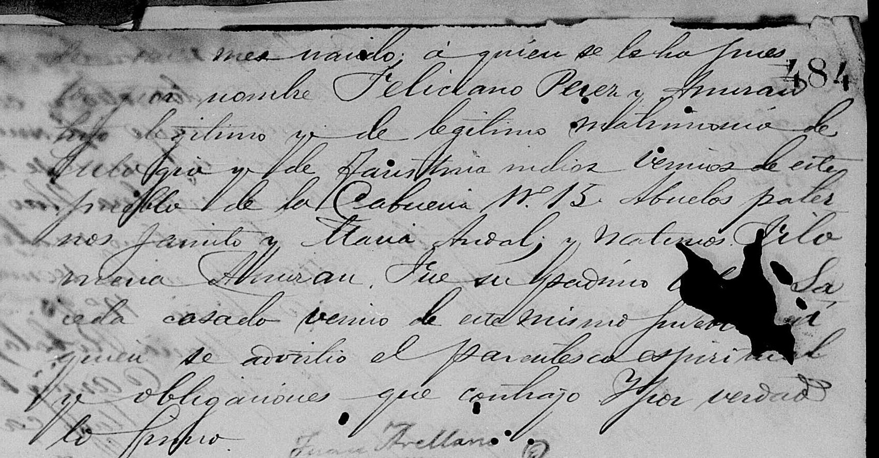
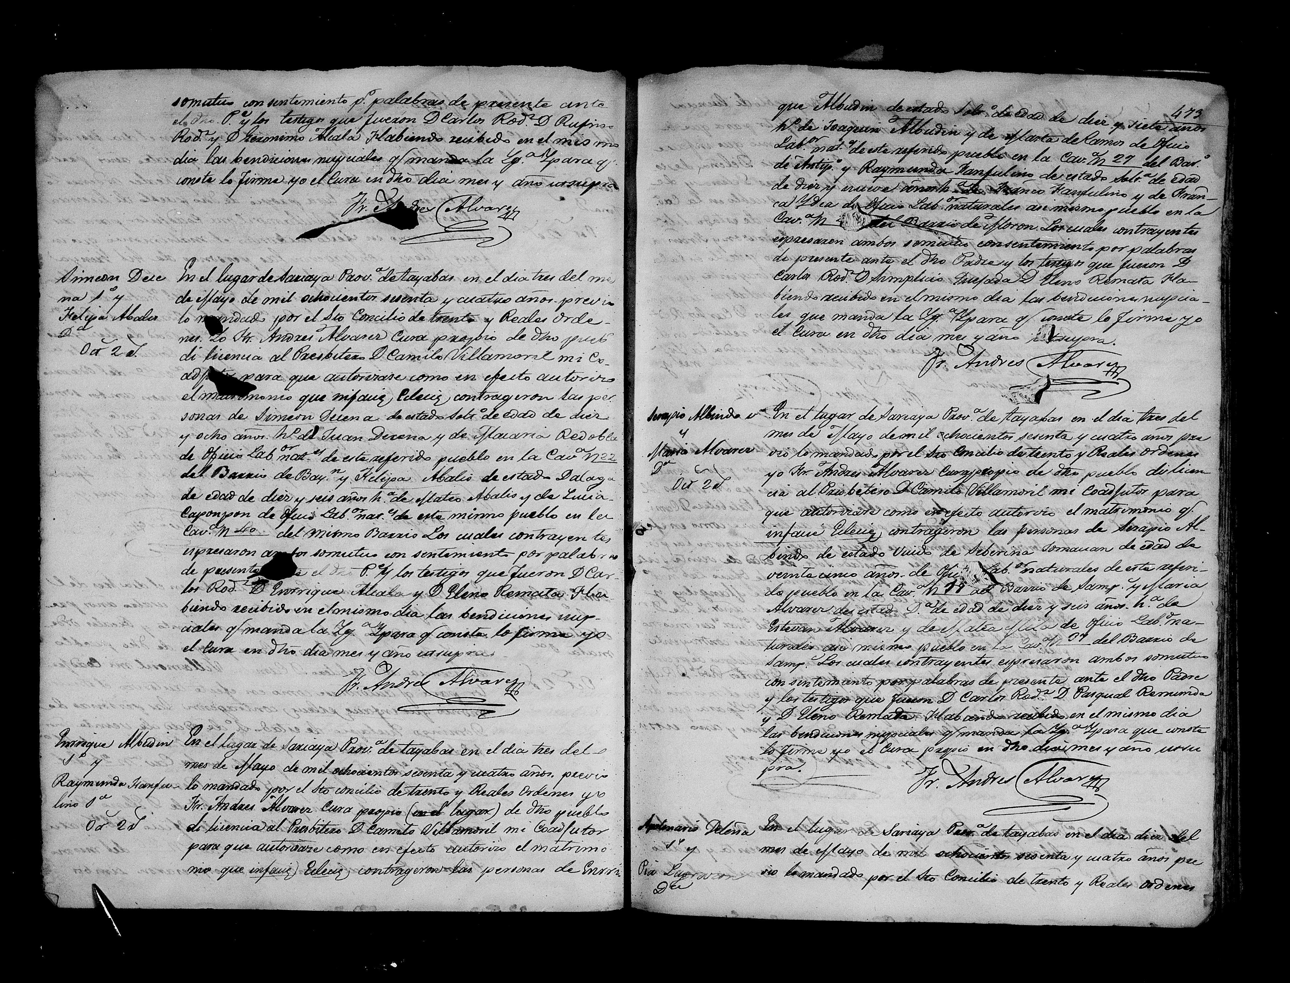


The Philippines was under Spanish rule from 1565 to 1898.

Slide 3

KEYWORDS

Slide 4
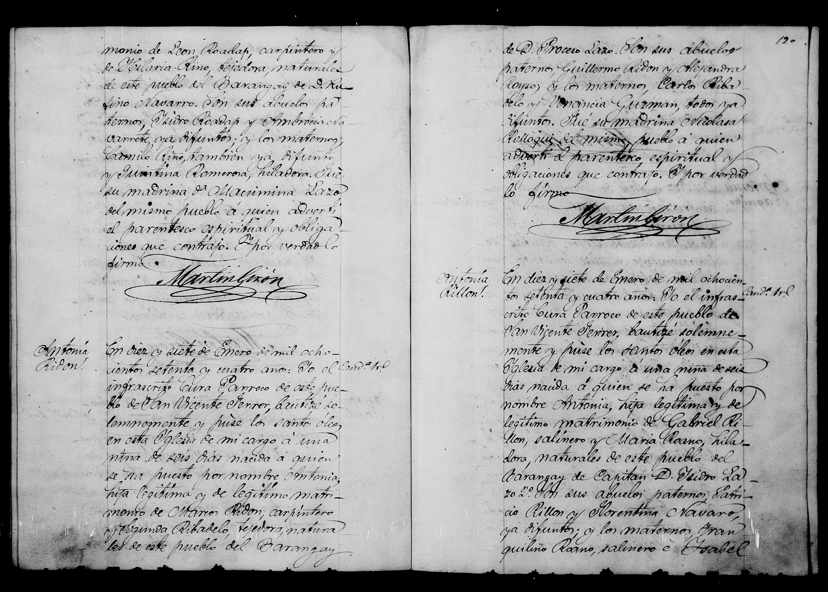
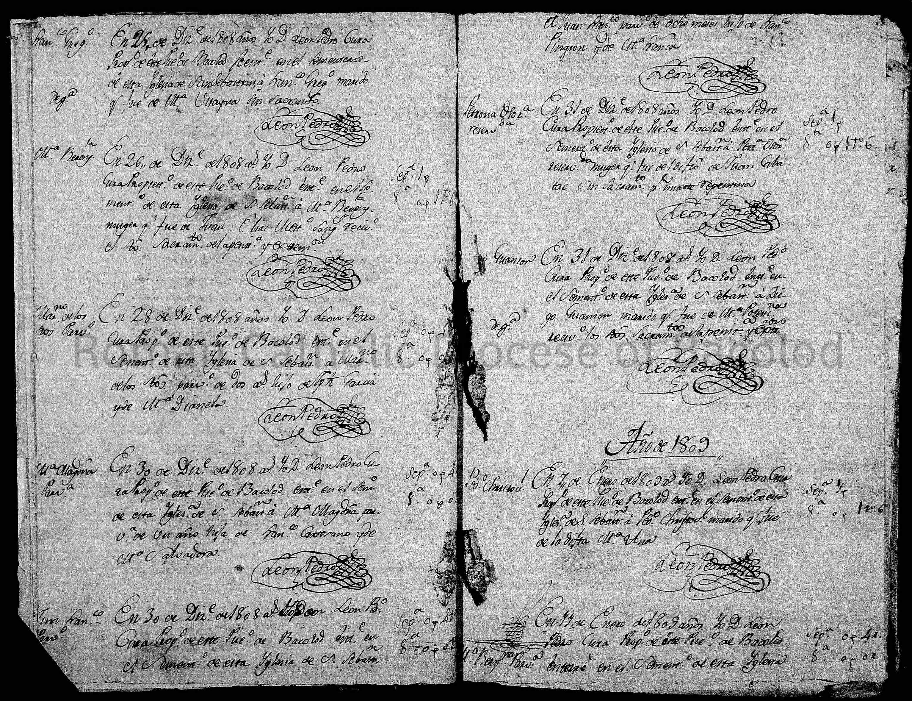
Baptismal
Bautizo/Bautize
Marriage
Matrimonio
Burial
Cadaver/Sepultado/
Entierros

Slide 5
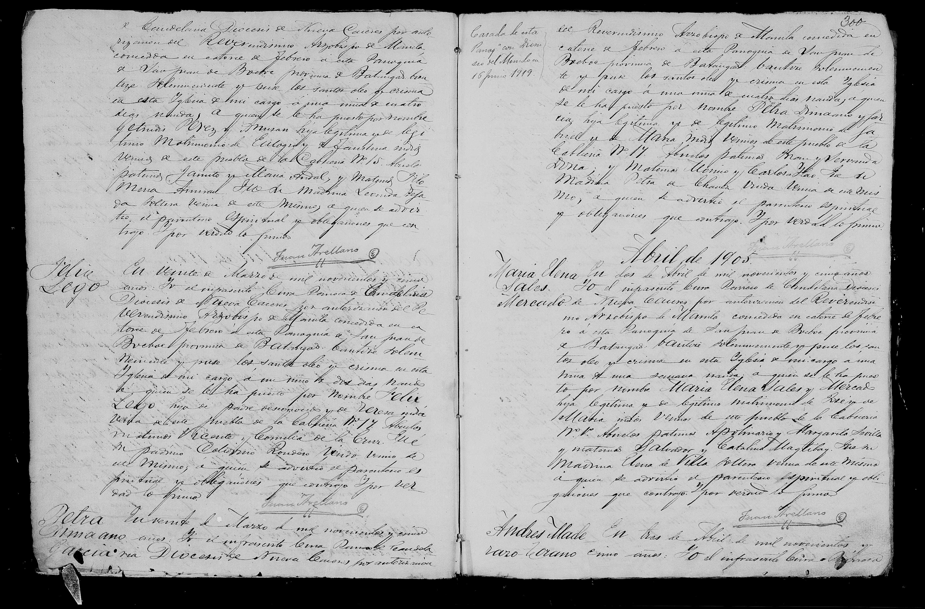
Baptismal
Nombre - to find the name of the child
Hijo/Hija legitimo y de legitimo matrimonio – to
find the parents name
Soltera – Single
Padre no conocido – Unknown father
Nacido – to see the age of the child when it was baptized
Abuelos Paternos/Maternos – to find the paternal
and maternal grandparents
Padrino/Madrino – to find the godfather or godmother
Pueblo/Barangay – if you want to see the residence

Slide 6
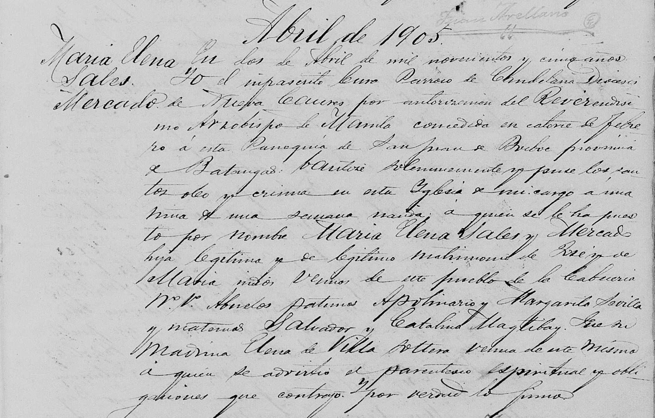

Slide 7
Marriage
Hijo/hija/soltero/soltera/indio/india/baguntao/dalaga – civil
Status/race of the bride and groom with
their names written before it.
The same keywords are then followed by
the names of the parents.
Viudo/viuda – followed by the name of their
deceased spouse.
Testigo – to find the names of the witnesses
Con – sometimes seen before the bride’s name
Abuelos Paternos/Maternos – to find the paternal
and maternal grandparents
Pueblo/Barangay – if you want to see the residence

Slide 8
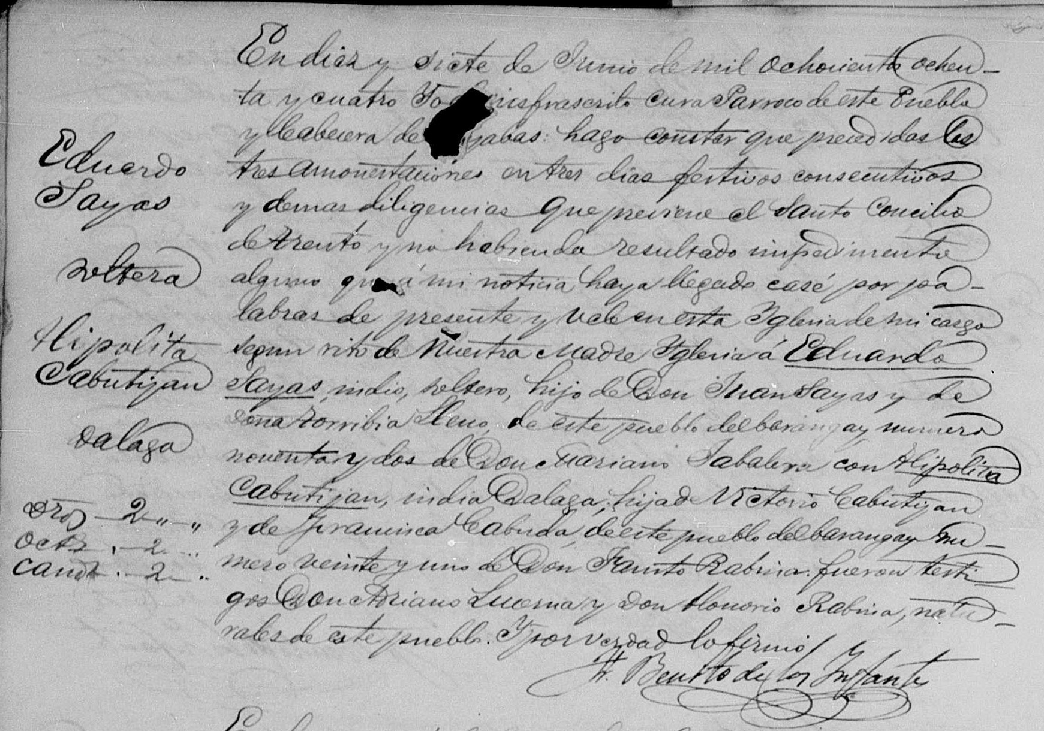

Slide 9
Burial
Nombre – written near the name
Hijo/hija legitimo – parents name are written
after this.
Casado con/Viudo/Viuda – name of
spouse written afterwards
Edad – age could be found before or after
this keyword.
Fallecio – indicate the day of death

Slide 10
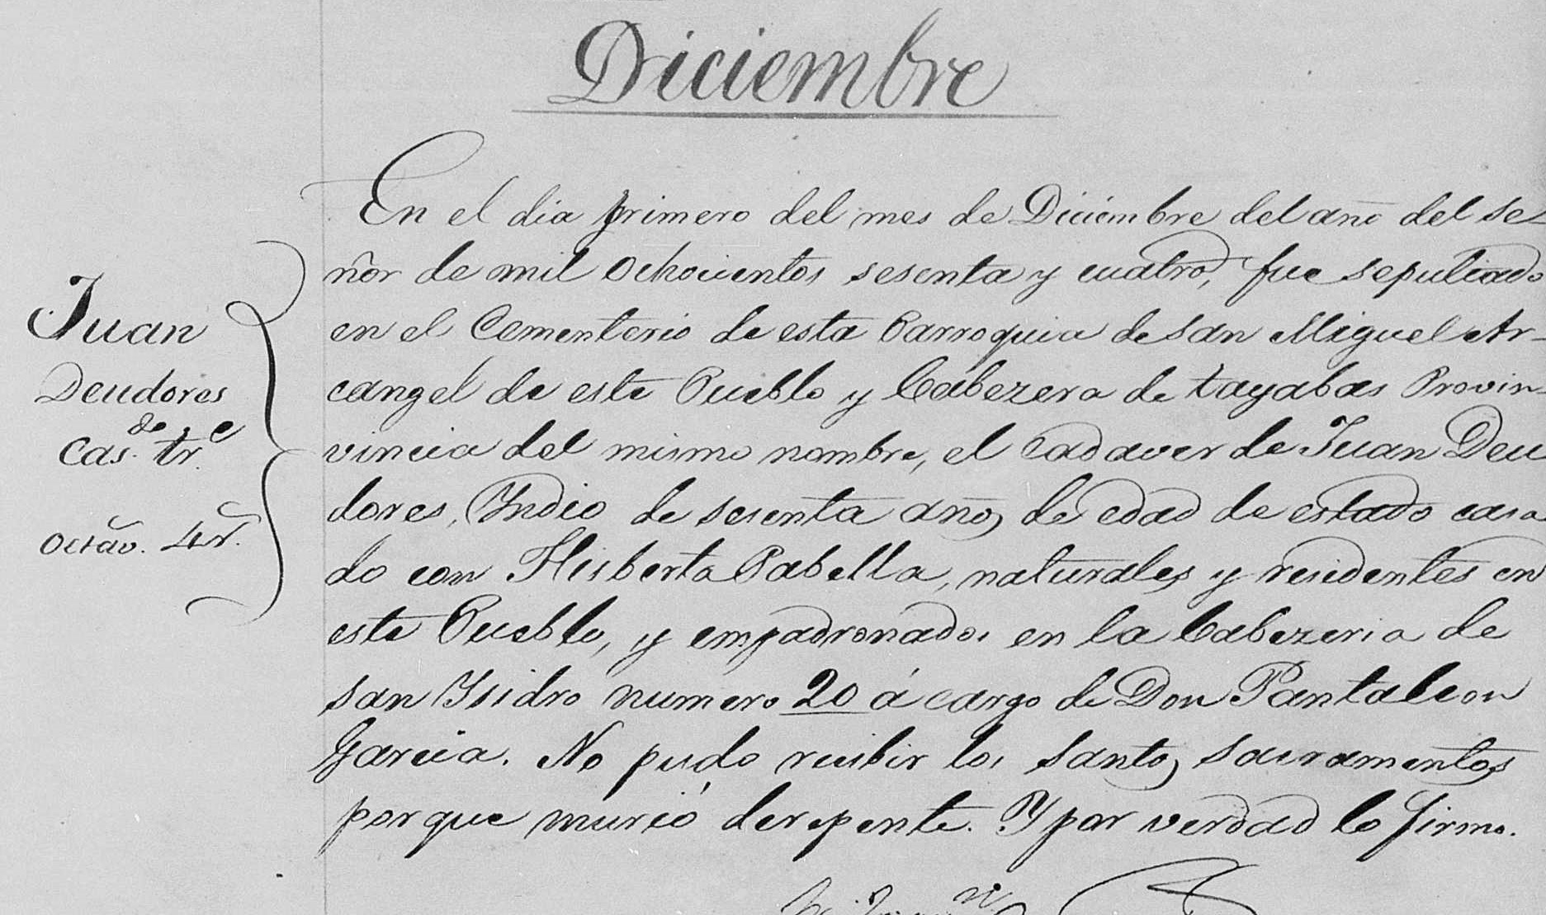

Slide 11
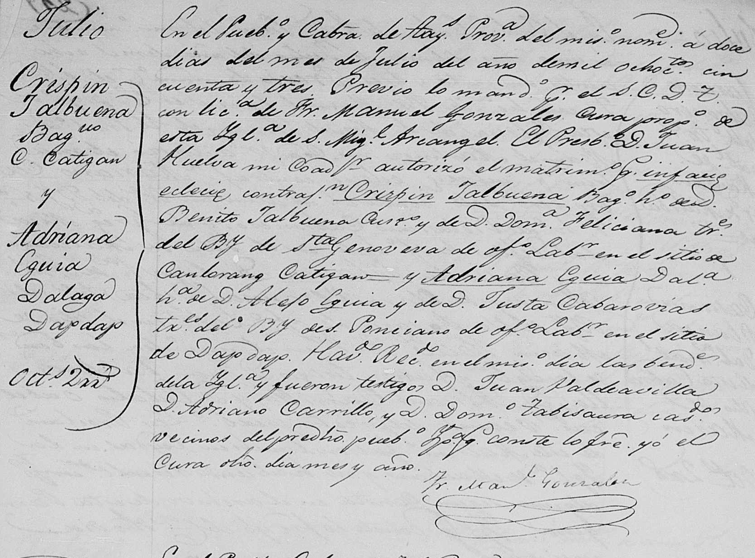
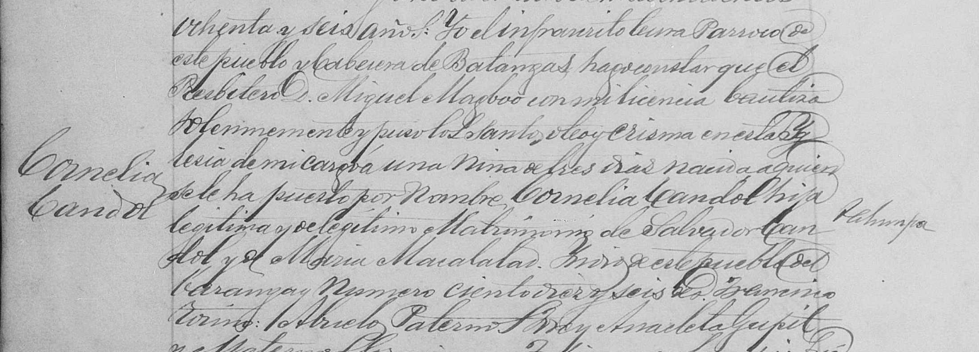
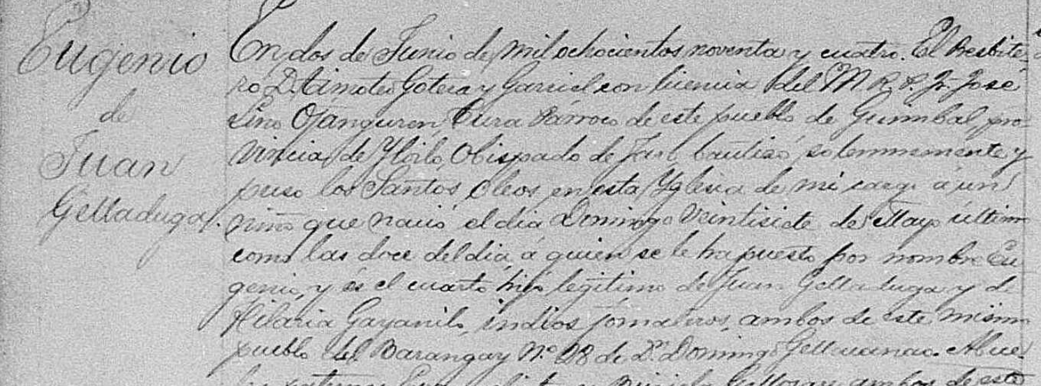

Slide 12
Reduce the overwhelming task of searching for
information in an unfamiliar language
Become comfortable researching these records
Helps build your confidence as a genealogist

Slide 13
Keyword is the Key!

