Slide 1
Introduction to Koseki Reading and Interpretation –
Part 1 (Introduction and Basic Layout)
Martinus (Marty) Wolf 狼

Slide 2
The content of this video, as well as the thoughts, views, and opinions expressed herein belong solely to the creator and do not necessarily reflect the views of FamilySearch International and RootsTech.

Slide 3
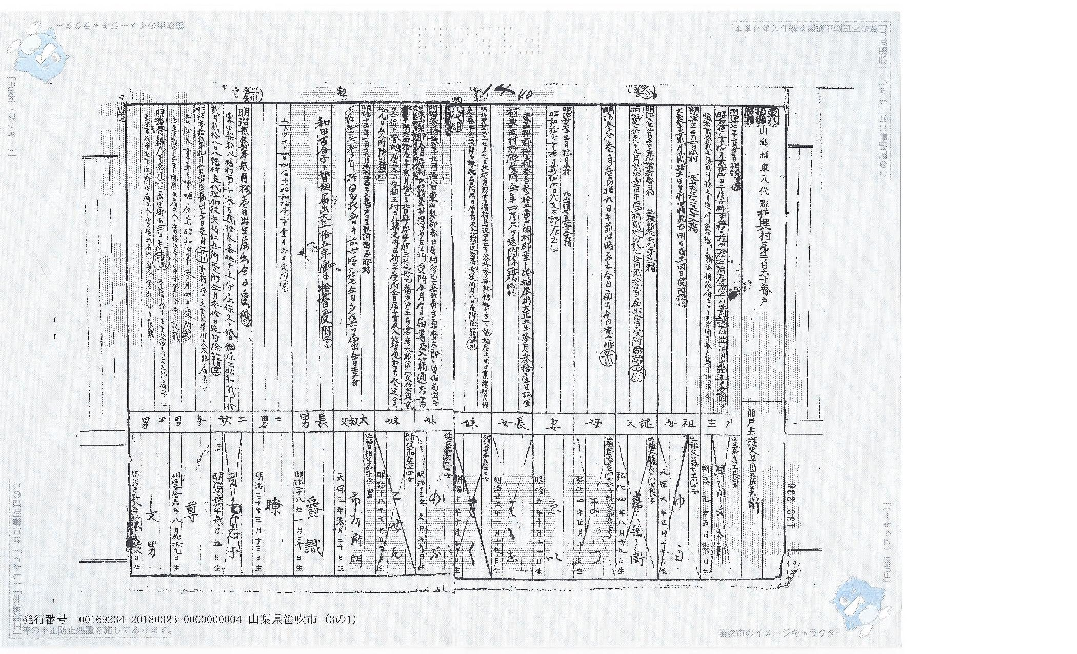
日本の家族歴史 (Japanese Family History)
Introduction to Koseki Reading and Interpretation
Part 1

Slide 4
Class Topics
Part 1
  Introduction
  Basic koseki layout
Part 2
  Dates
  Family Relationships
Part 3
  Names
  Geographic place names

Slide 5
Problem 1
You received your koseki documents
The documents are in Japanese
You only know English (or Portuguese or Spanish…)

Slide 6
Solution to Problem 1
Hire a translator
Find a Japanese friend
Use software (not yet there…)
Do it yourself?!?
Do it yourself

Slide 7
Problem Statement 2
There are too many kanji to learn
  Grades 1-6 – 1,026
  Grades 7-12 – 1,130 (2,136 total)
  Personal name use – 863 (2,999 total)
  Japanese Industrial Standards (JIS) – 10,050
  Largest Japanese kanji dictionary – 50,000
  Largest Chinese kanji dictionary – 85,000

Slide 8
Solution to Problem 2
DIY (at least partially)
  読む (yomu) – to read
  解読する (kaidoku suru) – to decode or decipher
Only a small subset of kanji are actually used in koseki documents

Slide 9
Starting to Decipher
Learn hiragana and katakana
  Used in many female names
  Useful in Japanese website navigation
y know English (or Portuguese or Spanish…)

Slide 10
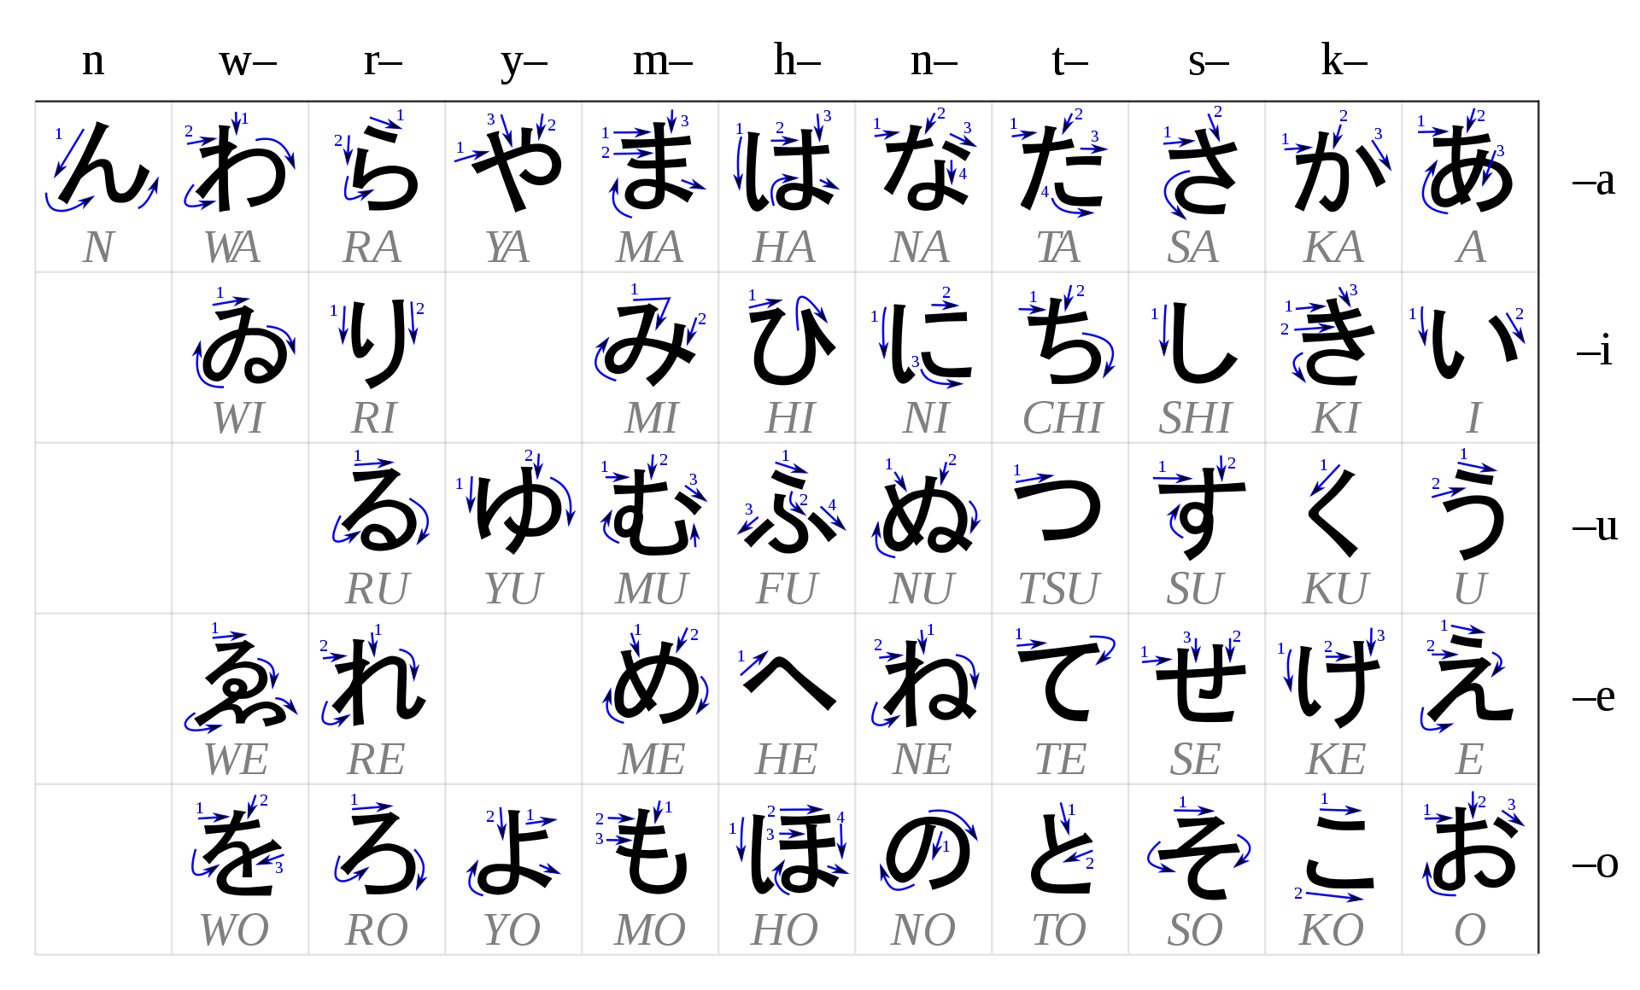

Slide 11
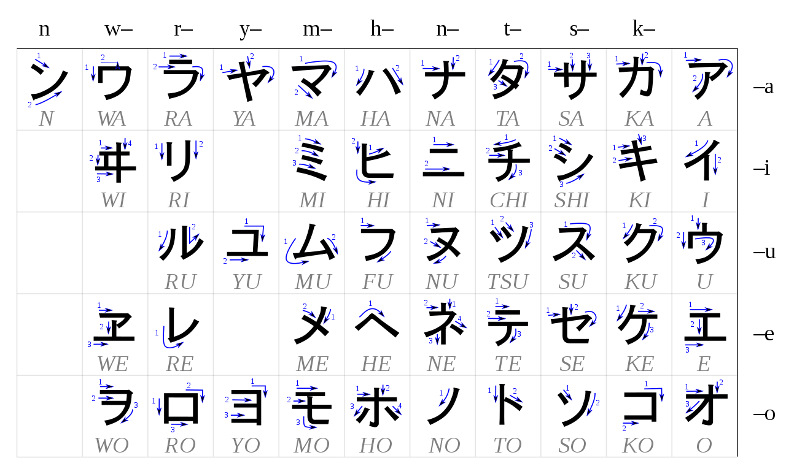

Slide 12
Sources for Kanji Recognition
“Japanese Kanji and Kana” – Hadamitzky and Spahn
www.jisho.org (excellent for beginners – no app)
https://www.kanjipedia.jp/ (administers kanji proficiency exams)
https://ejje.weblio.jp/ (good Japanese-English dictionary)
Google Translate
(or Portuguese or Spanish…)

Slide 13
戸籍の構成 (Koseki Layout)
Honsekichi (permanent residence/domicile) is on the first page (upper right)
Date of issuance and municipal office seal is on the last page (far left)
All writing is top-to-bottom and right-to-left (for most documents); left-to-right and top-to-bottom (for newer documents)
There will be many X’s for removed people – ignore the X’s
Head of household is listed first, then in order of household appearance
Primary information is on the bottom of the page; secondary information is on the top of the page
An individual may appear multiple times – divorce, annulled adoption

Slide 14
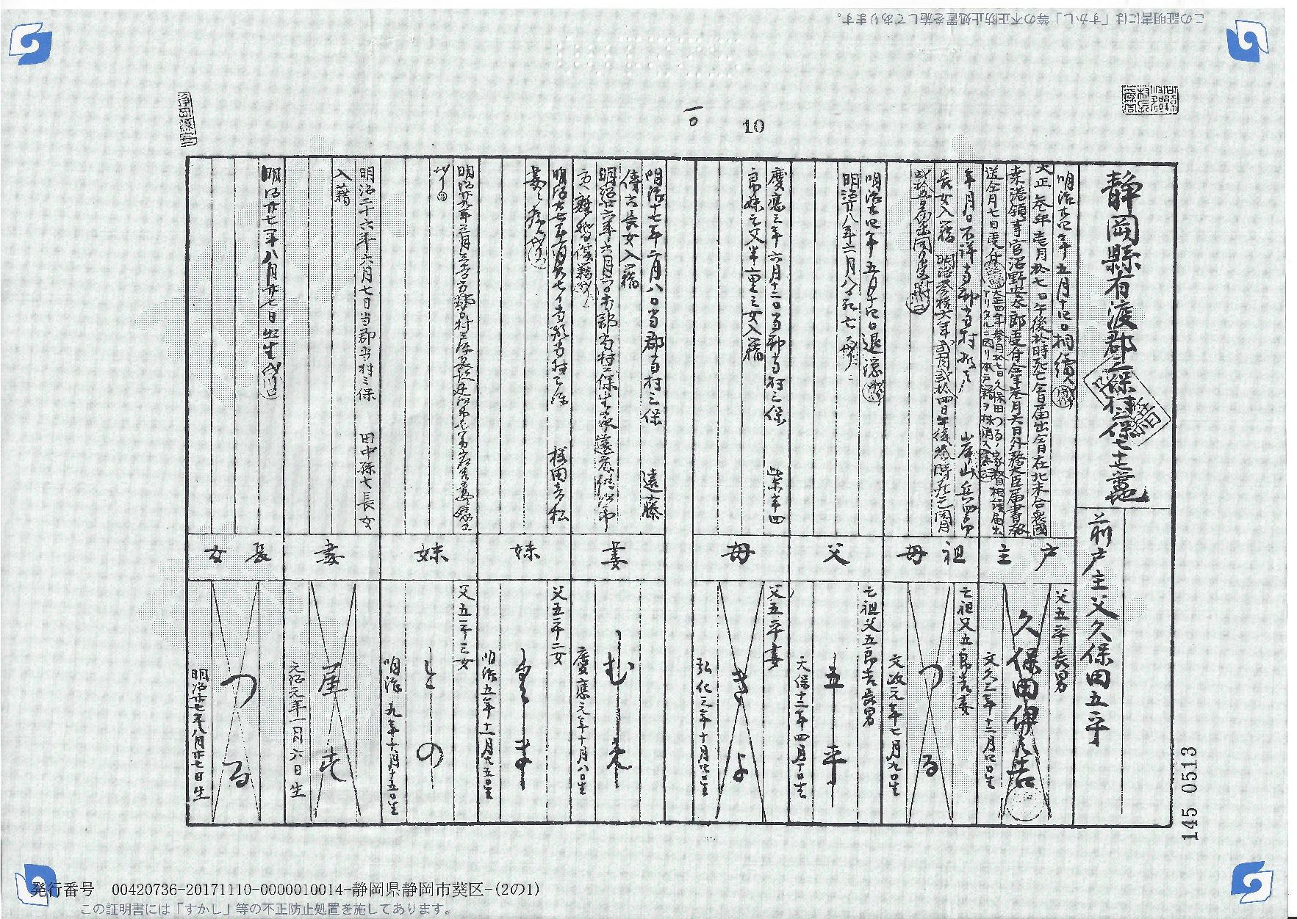
Honsekichi

Slide 15
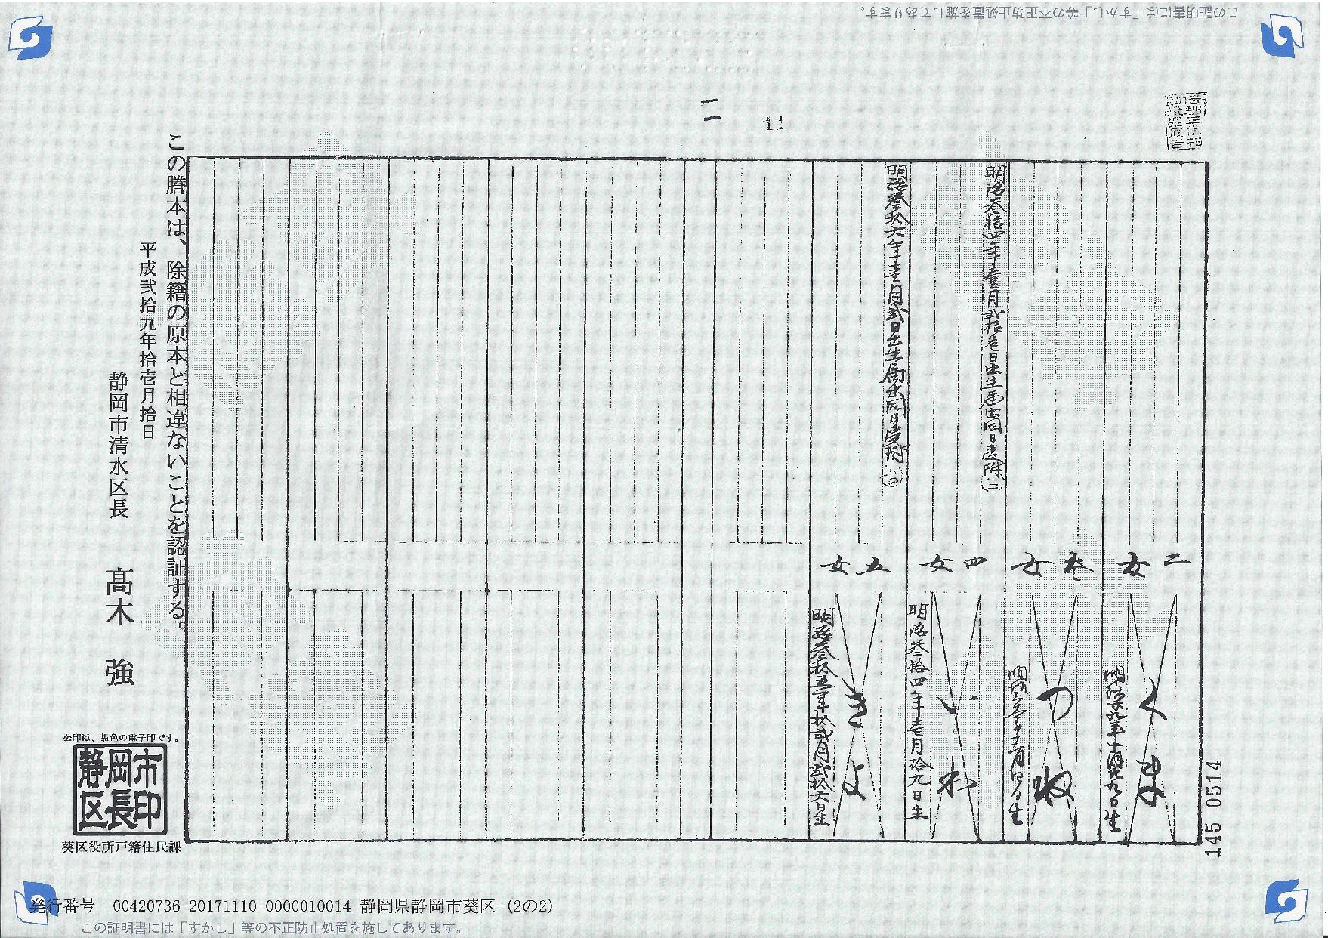
Date
Seal

Slide 16
Right to Left
Top to Bottom

Slide 17
X’s? Crossouts?

Slide 18
X’s? Crossouts? IGNORE!

Slide 19
Head of Household

Slide 20
Secondary Information
Primary Information

Slide 21
What is available in
Primary Information?
Name
Birthdate
Household position
An individual may appear multiple times – divorce, annulled adoption

Slide 22
What is available in Secondary Information?
Marriages in/out
  Date
  Name of spouse
  Names of parents
  Birth order
  Honsekichi
Adoptions in/out
  Date
  Names of biological/adoptive parents
  Honsekichi
Deaths
  Date and time
  Place
Establishment of new households
Divorces
Adoption annulments
Retirements
Required rewritings of koseki

Slide 24
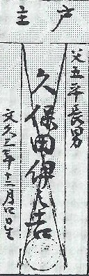
Primary Information - Details
C
A– First name (+ surname if head of household)
B – Birthdate (era, era year, month, date)
C – Position in household (relative to head of household)
D – Additional details (parents, step-parents, birth order, etc.)
B
A
D

Slide 25
Contacts
Marty Wolf (狼)
  916-540-9236 (text only please)
  marty_wolf@stanfordalumni.org
  Facebook (Martinus Wolf) (select the U.S.-based one)

